Slide 1




8/28/2020
Adobe Experience Manager User Interface
Agenda: Introduction to Adobe Experience Manager (AEM) Assets AEM user interface (UI) Navigate through the AEM consoles
1
Marketing challenges
85%
Under pressure to create assets and deliver more campaigns, more quickly
Slow time to market
71%
Creating over 10 times the assets today to support
increasing channels
Higher cost & complexity
76%
Personalization increaseses the need for more assets
Low engagement
Content Velocity
Proliferation of channels
Personalized Content
Lack of analytics & shared insights of content performance
IDC InfoBrief, Proving the Value of Digital Asset Management
2
© 2020 Adobe. All Rights Reserved
2
ADOBE DIGITAL LEARNING SERVICES

Slide 2
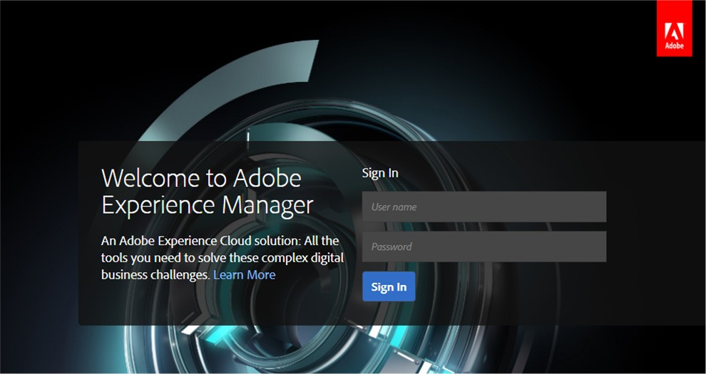


8/28/2020
AEM user interface | Sign In page
User name:
user0[01-20]
https://aemauthorXXX.adls.adobevlab.com
Password:
adl$Us3r
3
© 2020 Adobe. All Rights Reserved
3
ADOBE DIGITAL LEARNING SERVICES
Browser support
Google Chrome (current)
Safari 10+
Mozilla Firefox (current)
Microsoft Internet Explorer 11
Microsoft Edge (evergreen)
4
© 2020 Adobe. All Rights Reserved
4
ADOBE DIGITAL LEARNING SERVICES

Slide 3
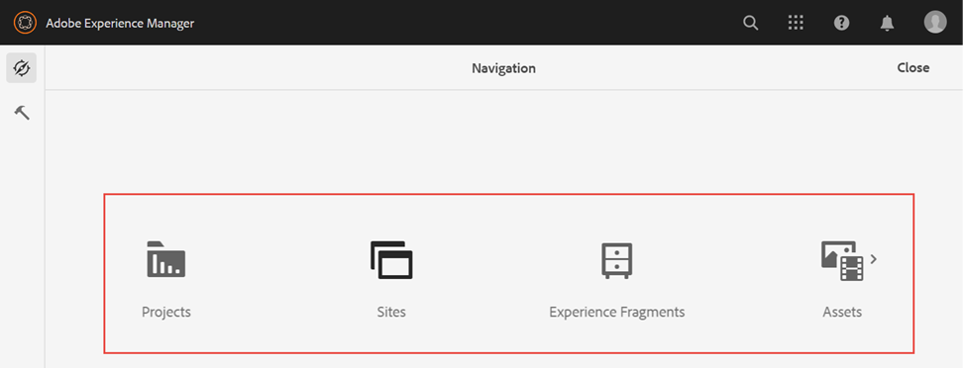
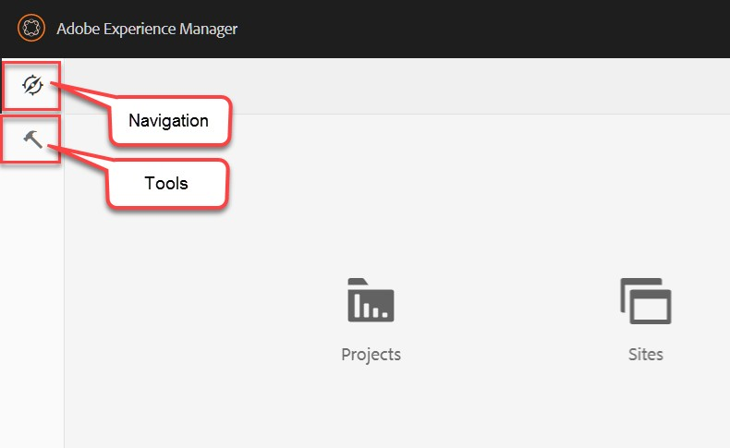
8/28/2020
Navigation
Navigation to the solution consoles
Manage:
Websites
Digital Assets
Experience Fragments
Projects
5
© 2020 Adobe. All Rights Reserved
5
ADOBE DIGITAL LEARNING SERVICES
Navigation and tools
Navigation
Displays all AEM capabilities available on the AEM UI
Tools
Administrative consoles
Developer tools
System monitoring tools
6
© 2020 Adobe. All Rights Reserved
6
ADOBE DIGITAL LEARNING SERVICES

Slide 4
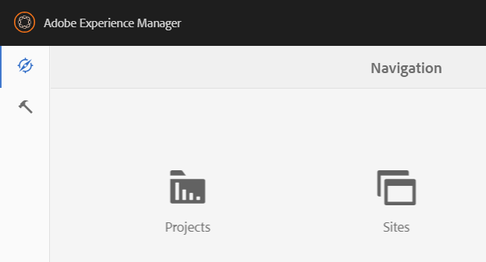
8/28/2020
Quick links on the header bar
Link to start AEM pages and consoles
Search
Inbox
User settings
Solutions
Help
7
© 2020 Adobe. All Rights Reserved
7
ADOBE DIGITAL LEARNING SERVICES
Home button
Back to the screen navigation
Click here
8
© 2020 Adobe. All Rights Reserved
8
ADOBE DIGITAL LEARNING SERVICES

Slide 5
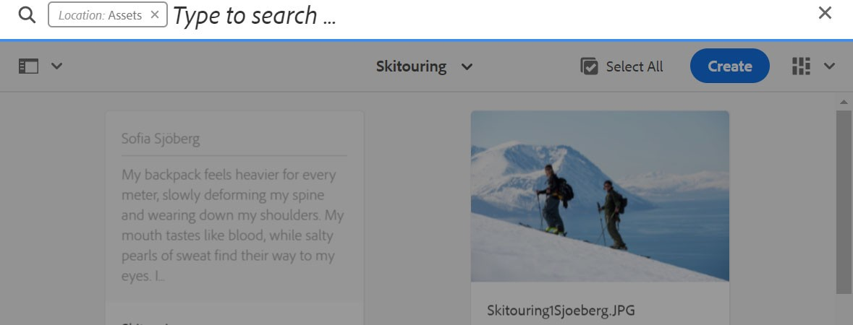
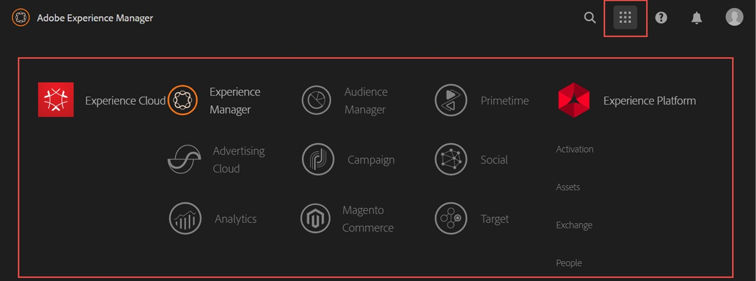
8/28/2020
Search: / (forward slash)
Search for site content, assets metadata, consoles, and tags
9
© 2020 Adobe. All Rights Reserved
9
ADOBE DIGITAL LEARNING SERVICES
Access other Adobe Experience Cloud solutions
10
© 2020 Adobe. All Rights Reserved
10
ADOBE DIGITAL LEARNING SERVICES

Slide 6

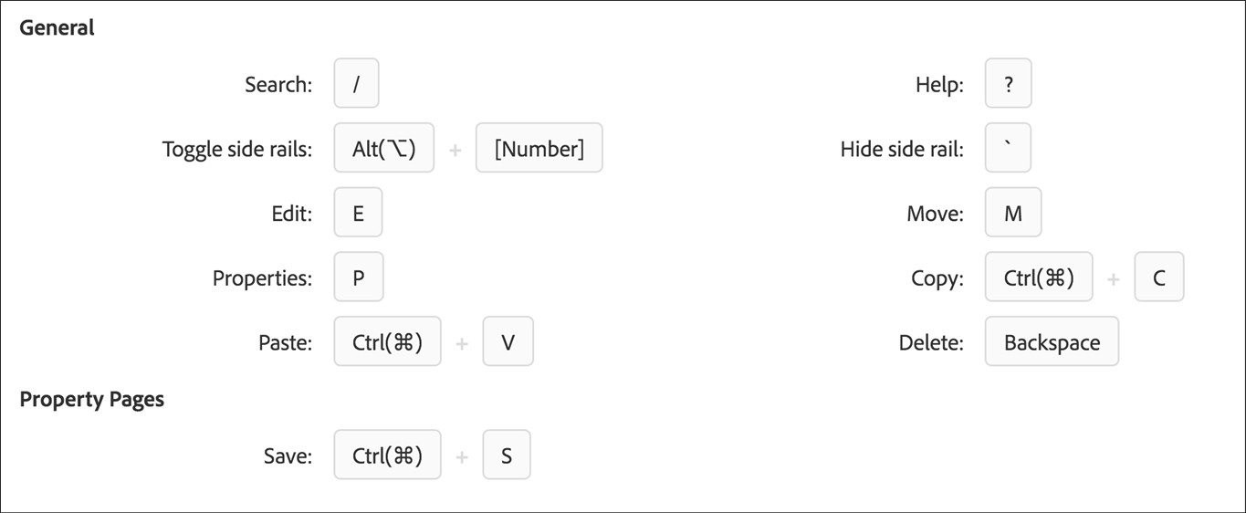
8/28/2020
Help
Documentation
Community forum
Customer care
Keyboard shortcuts
11
© 2020 Adobe. All Rights Reserved
11
ADOBE DIGITAL LEARNING SERVICES
Keyboard shortcuts
ADOBE DIGITAL LEARNING SERVICES
© 2020 Adobe. All Rights Reserved ADOBE DIGITAL LEARNING SERVICES
12
© 2020 Adobe. All Rights Reserved.
12

Slide 7
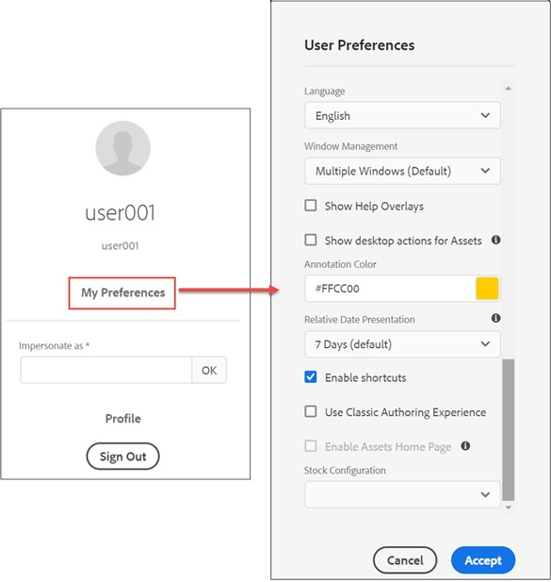
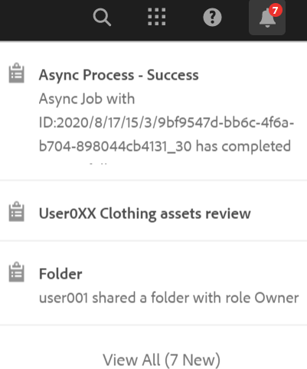
8/28/2020
User preferences | language
13
© 2020 Adobe. All Rights Reserved
13
ADOBE DIGITAL LEARNING SERVICES
Inbox
14
© 2020 Adobe. All Rights Reserved
14
ADOBE DIGITAL LEARNING SERVICES

Slide 8
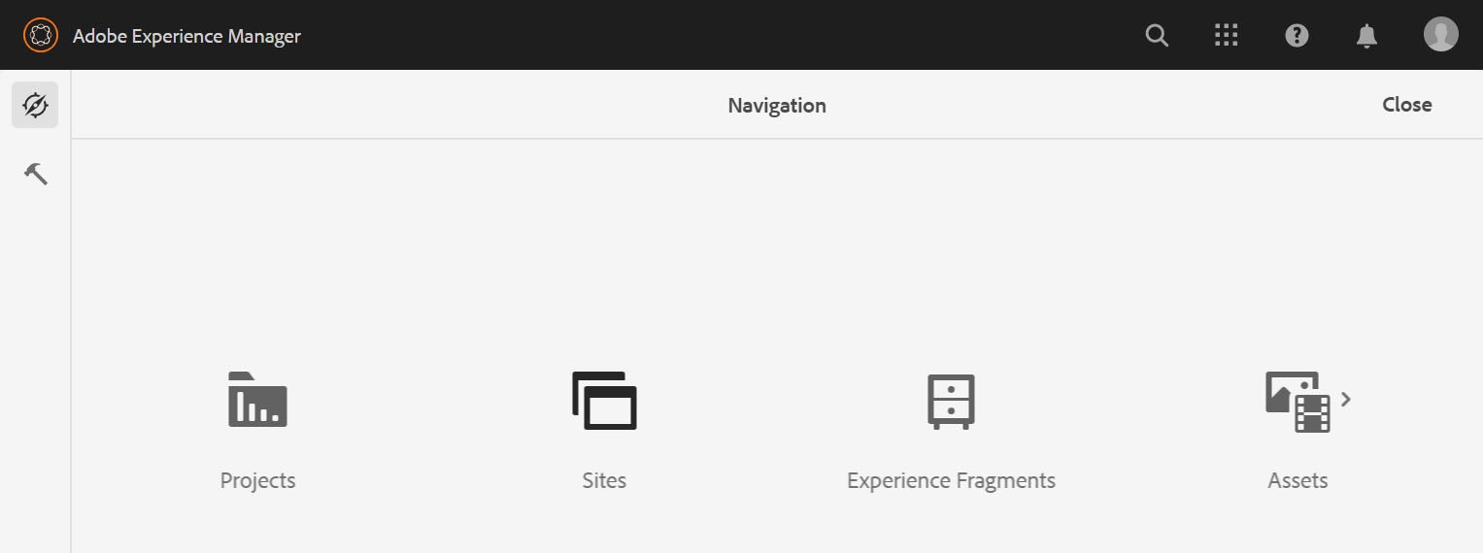
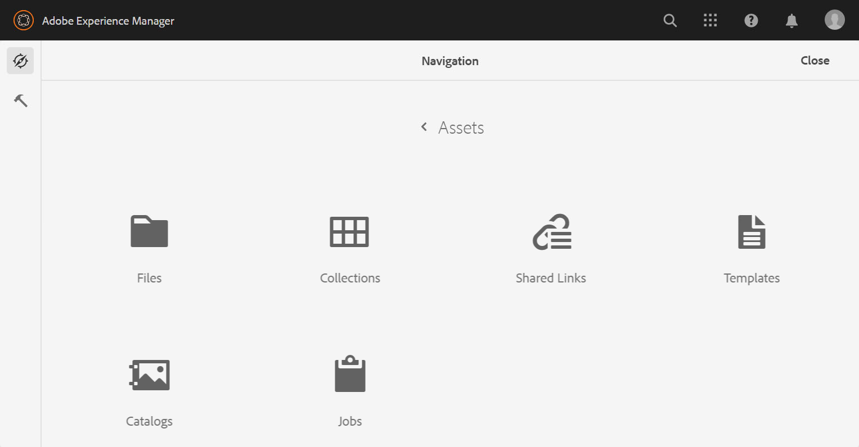




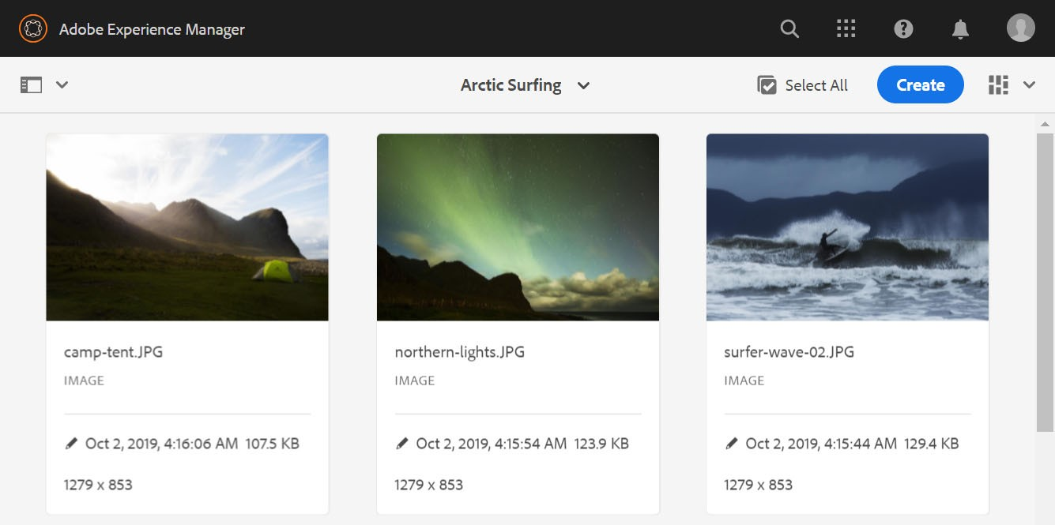
8/28/2020
Navigate to the Assets console
2
1
Console shortcut: https://aemauthorXXX.adls.adobevlab.com/assets
15
© 2020 Adobe. All Rights Reserved
15
ADOBE DIGITAL LEARNING SERVICES
View switcher
16
© 2020 Adobe. All Rights Reserved
16
ADOBE DIGITAL LEARNING SERVICES

Slide 9
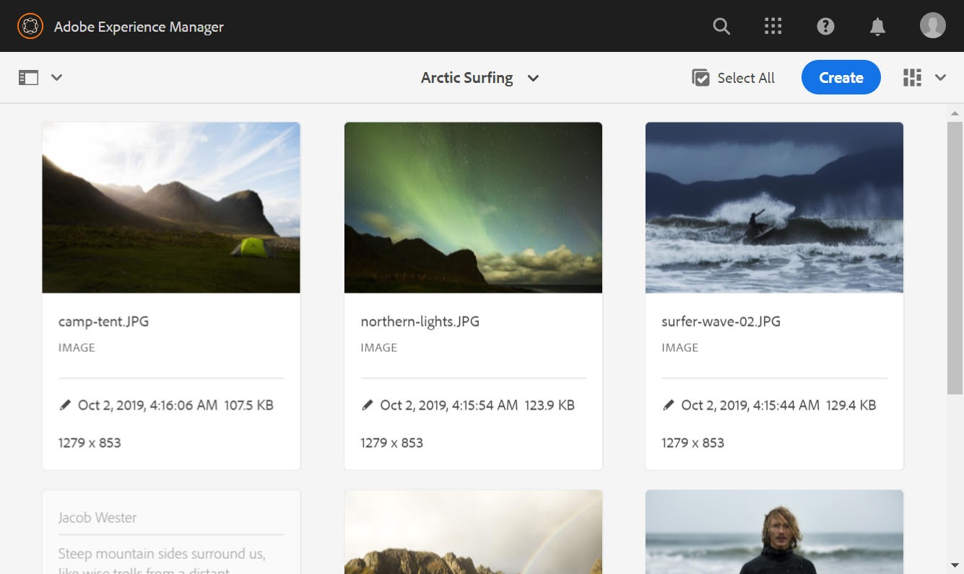
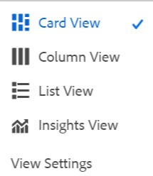

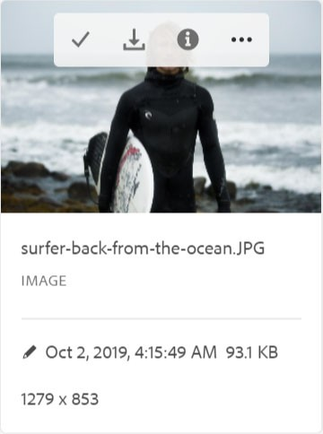

8/28/2020
Card View
17
© 2020 Adobe. All Rights Reserved
17
ADOBE DIGITAL LEARNING SERVICES
Card details
Asset information
Hover over to view buttons
18
© 2020 Adobe. All Rights Reserved
18
ADOBE DIGITAL LEARNING SERVICES

Slide 10
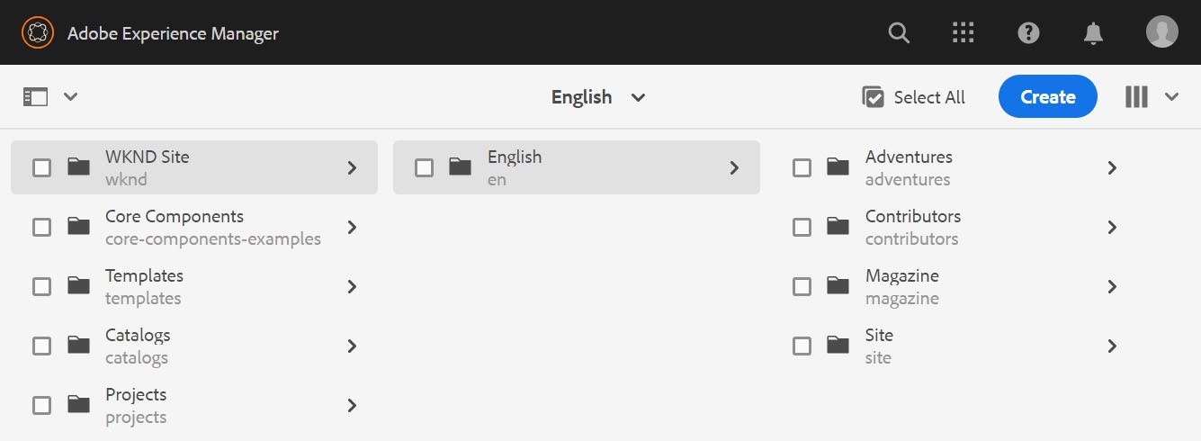
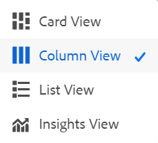
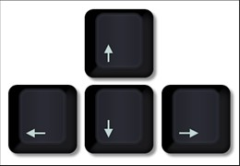
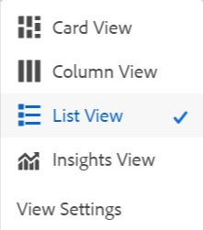
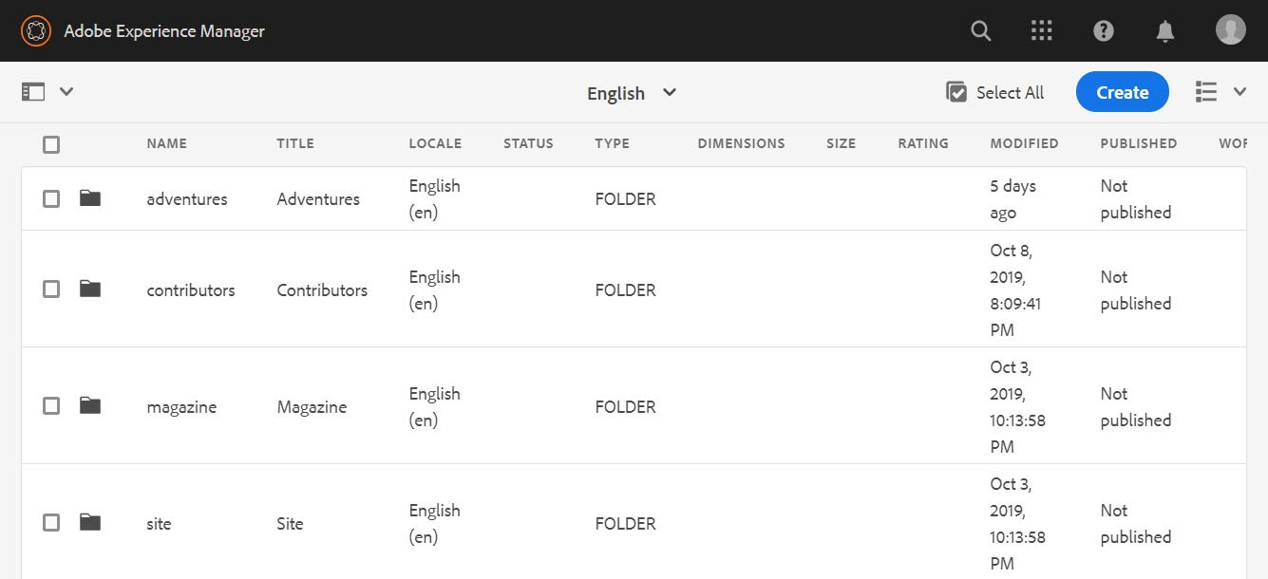
8/28/2020
Column View
Click text or the arrow (>) icon.
Navigate with your arrow keys ↑↓←→
19
© 2020 Adobe. All Rights Reserved
19
ADOBE DIGITAL LEARNING SERVICES
List View
20
© 2020 Adobe. All Rights Reserved
20
ADOBE DIGITAL LEARNING SERVICES

Slide 11
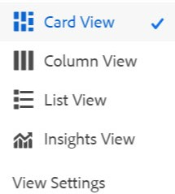
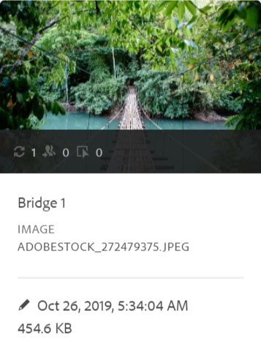
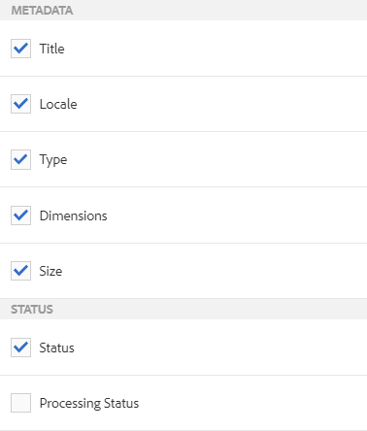
8/28/2020
Insights View
21
© 2020 Adobe. All Rights Reserved
21
ADOBE DIGITAL LEARNING SERVICES
View Settings
22
© 2020 Adobe. All Rights Reserved
22
ADOBE DIGITAL LEARNING SERVICES

Slide 12
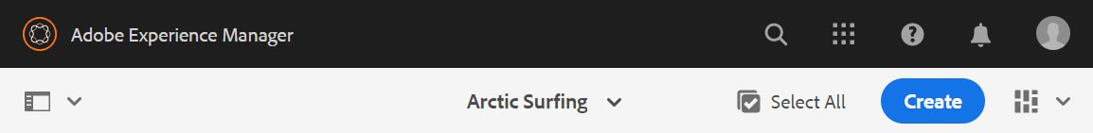
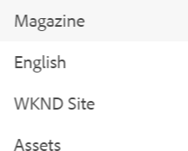
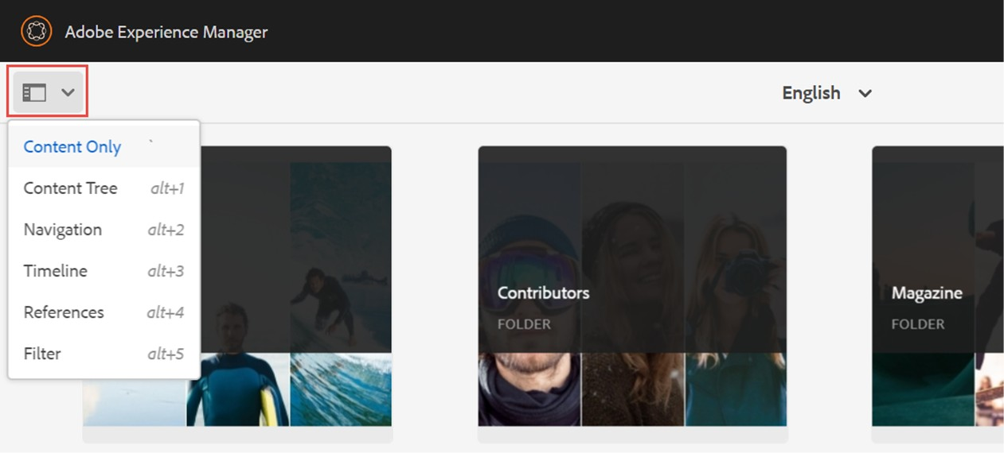
8/28/2020
Breadcrumbs
Navigate up the content hierarchy
23
© 2020 Adobe. All Rights Reserved
23
ADOBE DIGITAL LEARNING SERVICES
Rail Selector
Click here.
24
© 2020 Adobe. All Rights Reserved
24
ADOBE DIGITAL LEARNING SERVICES

Slide 13
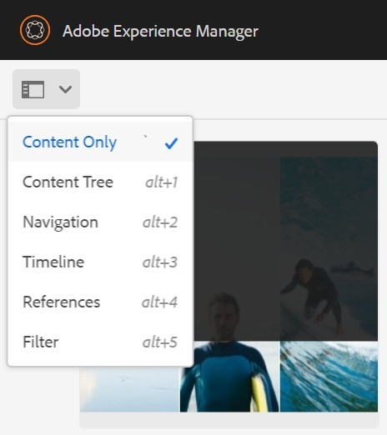
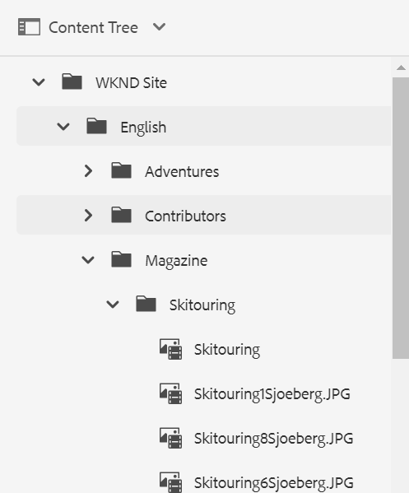
8/28/2020
Content Only
Default view that maximizes the content view
25
© 2020 Adobe. All Rights Reserved
25
ADOBE DIGITAL LEARNING SERVICES
Content Tree
Quickly Navigate through site hierarchy
Shortcut: alt+1
26
© 2020 Adobe. All Rights Reserved
26
ADOBE DIGITAL LEARNING SERVICES

Slide 14
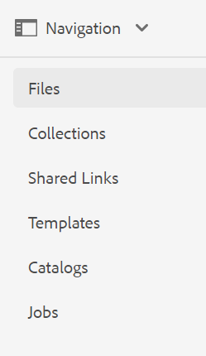

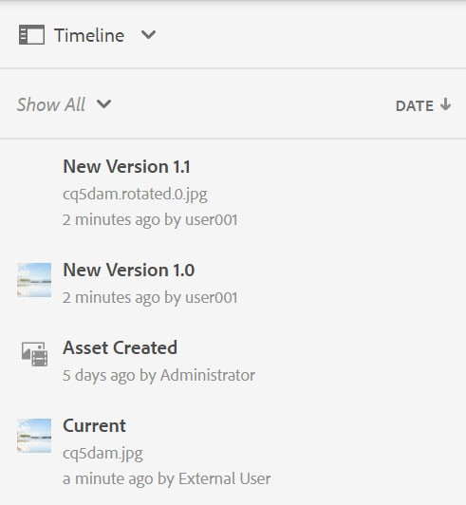
8/28/2020
Navigation
Quick view to navigate between different asset consoles
Shortcut: alt+2
27
© 2020 Adobe. All Rights Reserved
27
ADOBE DIGITAL LEARNING SERVICES
Timeline
View different events of a page
Comments
Workflows
Versions
Activities
Shortcut: alt+3
28
© 2020 Adobe. All Rights Reserved
28
ADOBE DIGITAL LEARNING SERVICES

Slide 15
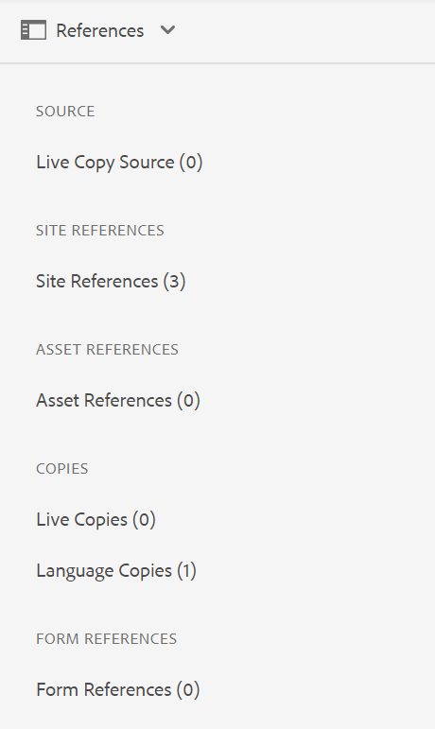
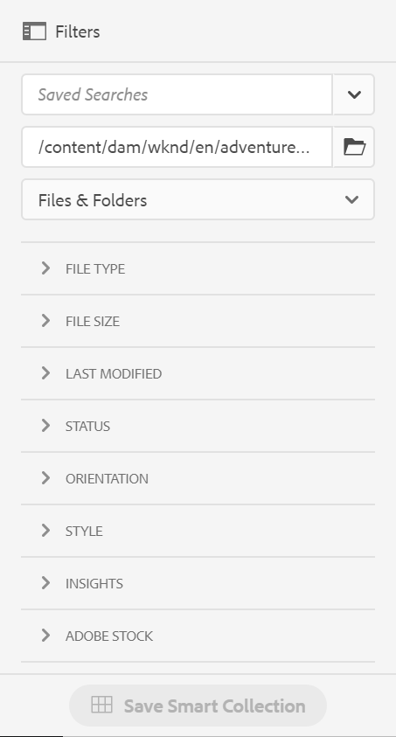
8/28/2020
References
View all references associated with an asset
Shortcut: alt+4
29
© 2020 Adobe. All Rights Reserved
29
ADOBE DIGITAL LEARNING SERVICES
Filter
Helps search filters to better define search results
Can be used in combination with full text search
Shortcut: alt+5
30
© 2020 Adobe. All Rights Reserved
30
ADOBE DIGITAL LEARNING SERVICES

Slide 16
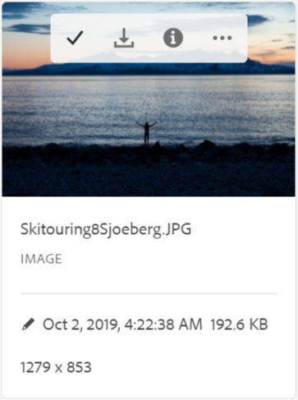
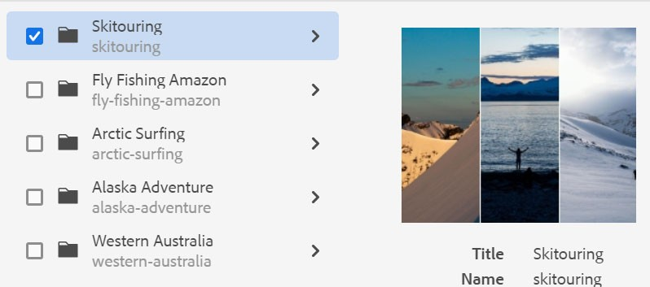
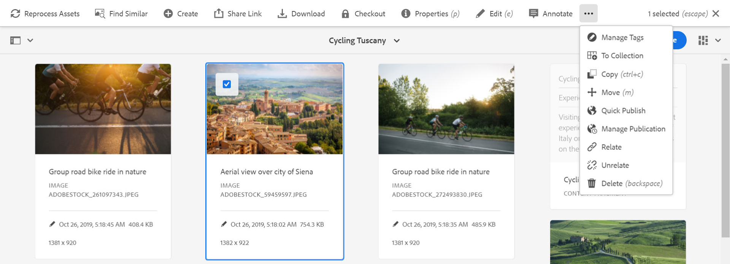
8/28/2020
Perform an action
Select one or many pages
Actions bar is exposed
Actions Bar
Column or List View
Card View
31
© 2020 Adobe. All Rights Reserved
31
ADOBE DIGITAL LEARNING SERVICES
Actions bar
32
© 2020 Adobe. All Rights Reserved
32
ADOBE DIGITAL LEARNING SERVICES

Slide 17


8/28/2020
Navigation is the entry point to the Assets console.
The Assets console helps import, manage, and share digital assets.
You can explore the assets in:
List view
Card view
Column view
Insights views
Key Takeaways
33
© 2020 Adobe. All Rights Reserved. Adobe Confidential.
33
ADOBE DIGITAL LEARNING SERVICES
Organizing Assets in Adobe Experience Manager
Agenda: Navigate through the Assets console Methods to organize assets Create a private folder and upload assets to the folder Add assets to a collections Add assets to a lightbox collection Create a collection with static references Remove an asset from a static collection Enable user permissions for a private folder Reorganize the assets within a folder Download an asset folder to your local file system
34

Slide 18
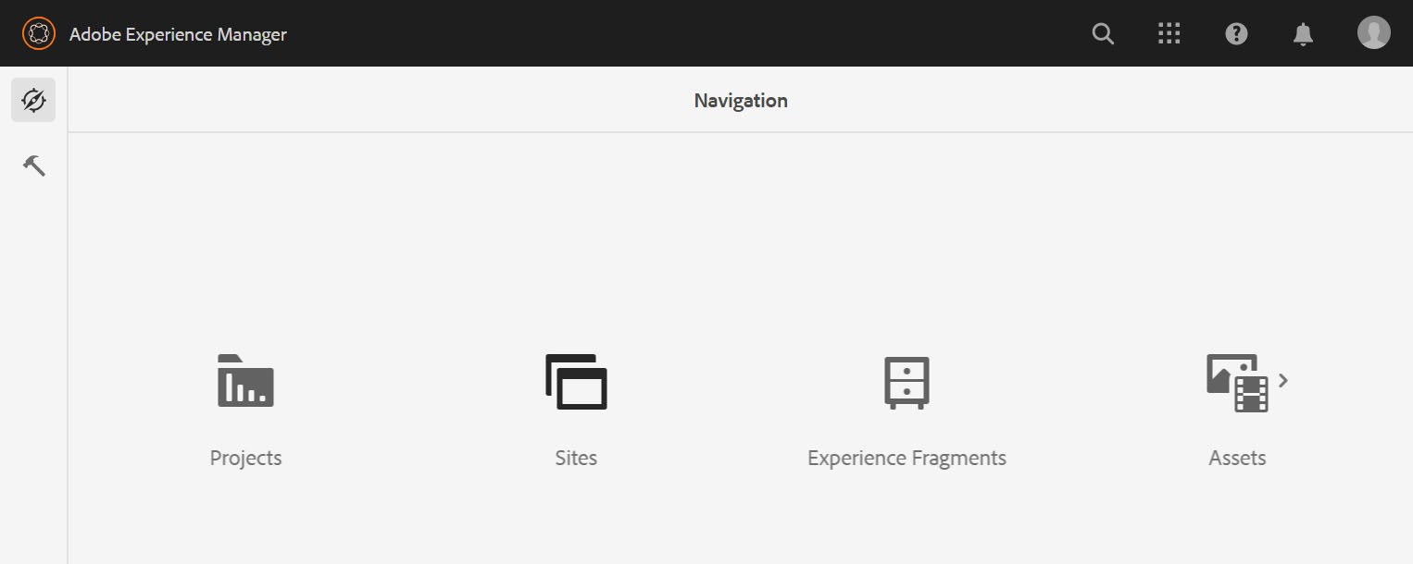
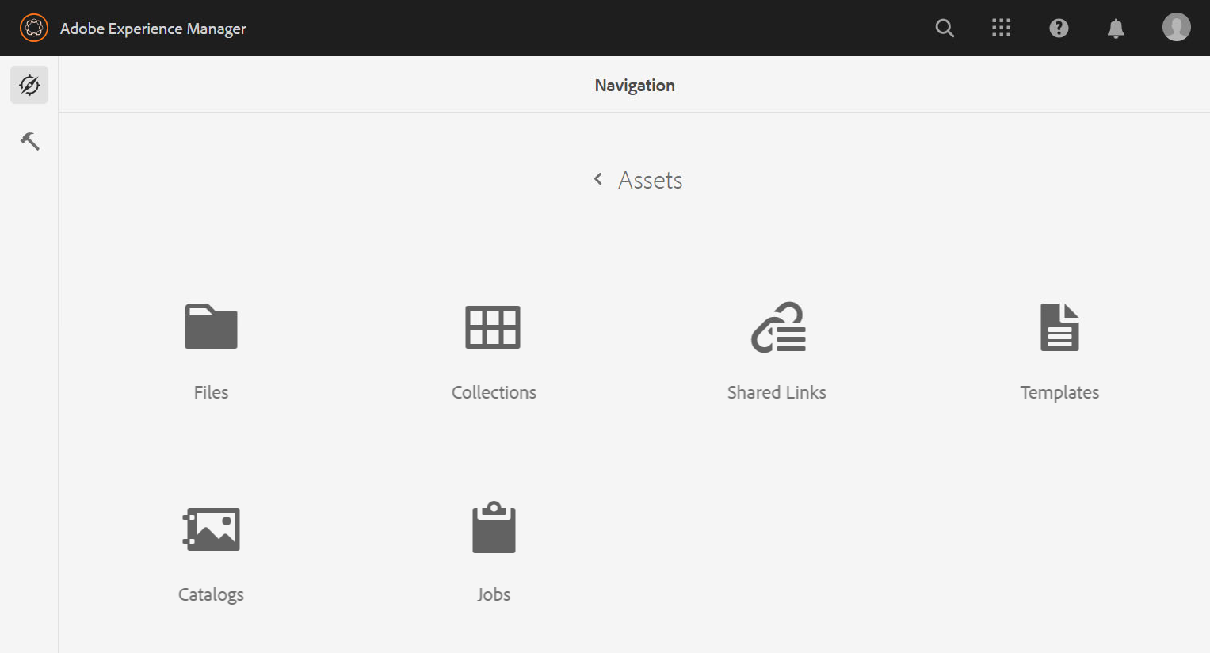
8/28/2020
Assets console
Navigation panel > Assets console
Import and manage digital assets
35
© 2020 Adobe. All Rights Reserved
35
ADOBE DIGITAL LEARNING SERVICES
Assets console | Options
The Assets console contains:
Files
Collections
Shared Links
Templates
Catalogs
Jobs
36
© 2020 Adobe. All Rights Reserved
36
ADOBE DIGITAL LEARNING SERVICES

Slide 19
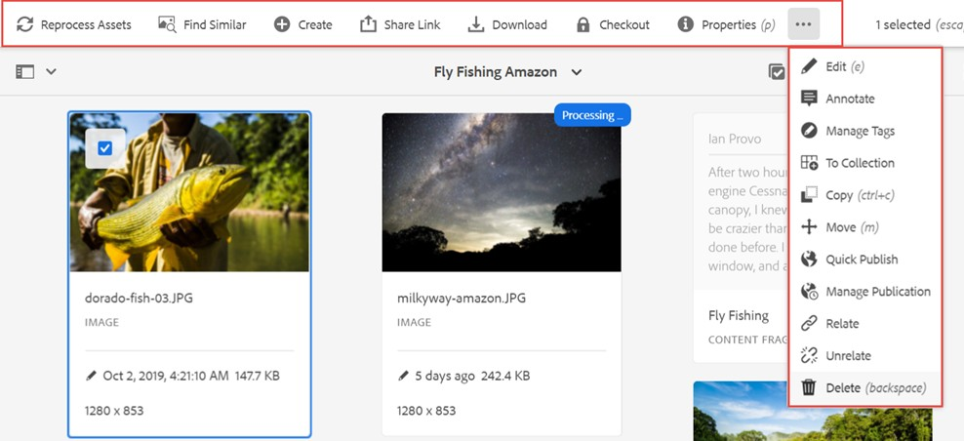


8/28/2020
Asset actions
Reprocess Assets Create
Share Download Checkout
Properties Edit Annotate Manage Tags
Reruns the asset ingestion process
Initiates a workflow or creates an asset version
Shares assets with the members of your organization and external entities
Downloads an asset to your local computer
Locks the asset to avoid overriding other users’ work
Views and edits the asset properties Resizes (crop, rotate, and flip) an asset Adds a comment to an asset
Adds tags and smart tags to an asset
37
© 2020 Adobe. All Rights Reserved
37
ADOBE DIGITAL LEARNING SERVICES
Asset actions
To Collection Copy
Move
Quick Publish
Manage Publication Relate
Unrelate Delete
Adds an asset to a collection
Copies an asset to create a brand-new asset
Moves an asset from one folder to another
Publishes an asset that is ready to be delivered immediately
Manages when to publish or unpublish and what content to publish
Links assets that have some type of relationship
Unlinks or removes the relation from the asset Deletes an asset
38
© 2020 Adobe. All Rights Reserved
38
ADOBE DIGITAL LEARNING SERVICES

Slide 20
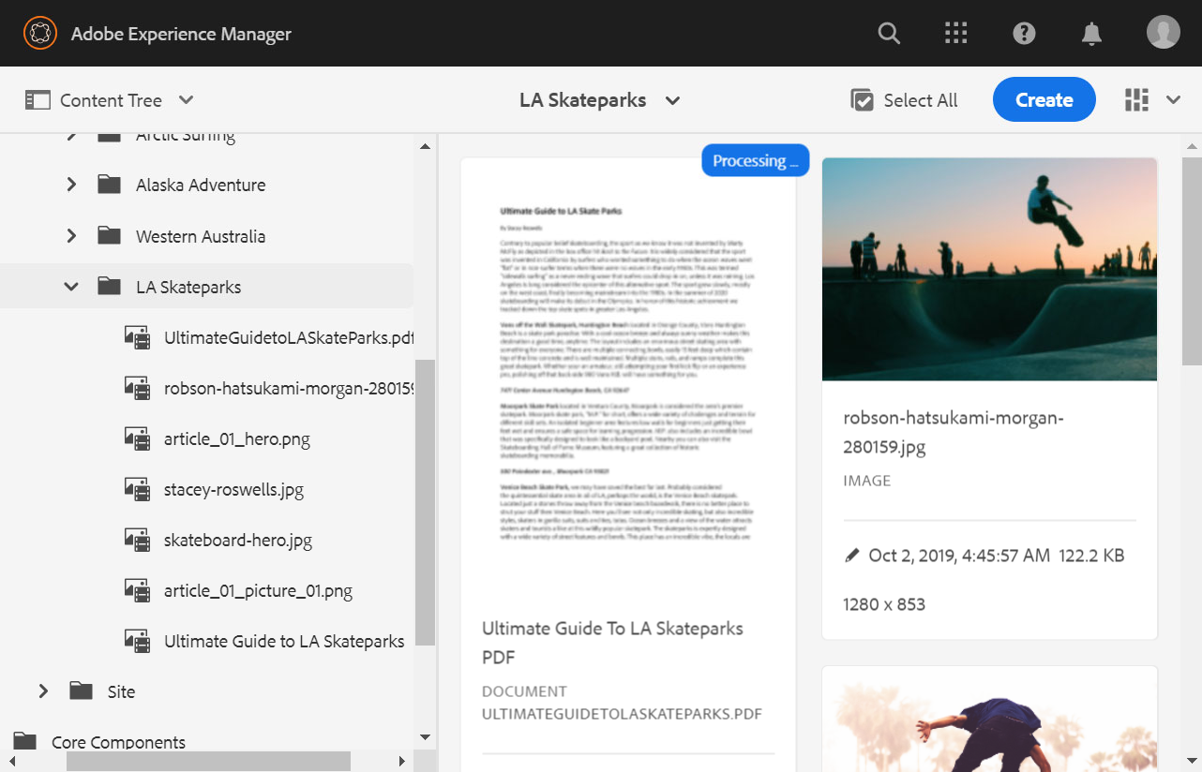
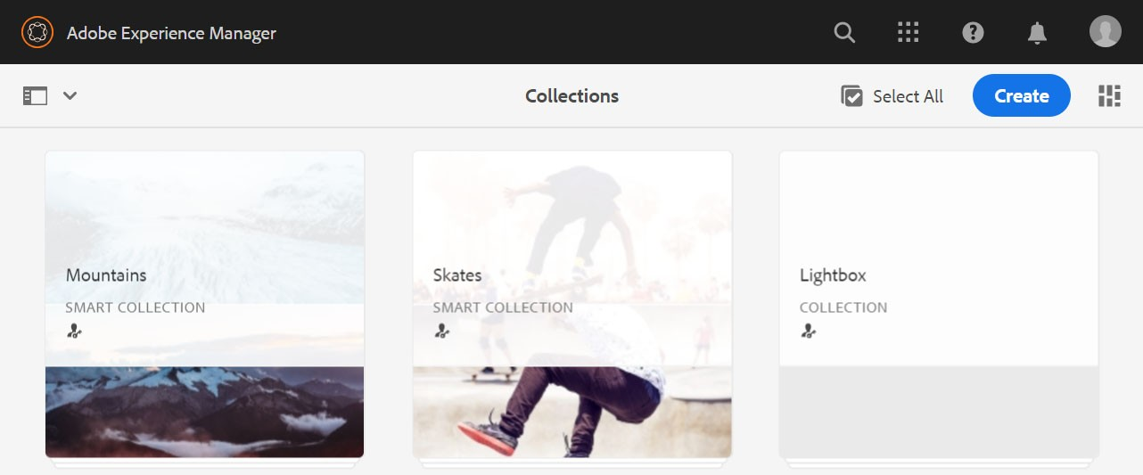


8/28/2020
Organizing assets Methods to organize assets:
Folder Hierarchy Collections
© 2020 Adobe. All Rights Reserved 39 ADOBE DIGITAL LEARNING SERVICES
39
Asset folders
Folders help organize assets
Asset folders can be:
Private: Accessible only to the folder owner and to anyone it is shared with
Public: Accessible to all the users in the organization who perform common tasks on assets
40
© 2020 Adobe. All Rights Reserved
40
ADOBE DIGITAL LEARNING SERVICES

Slide 21
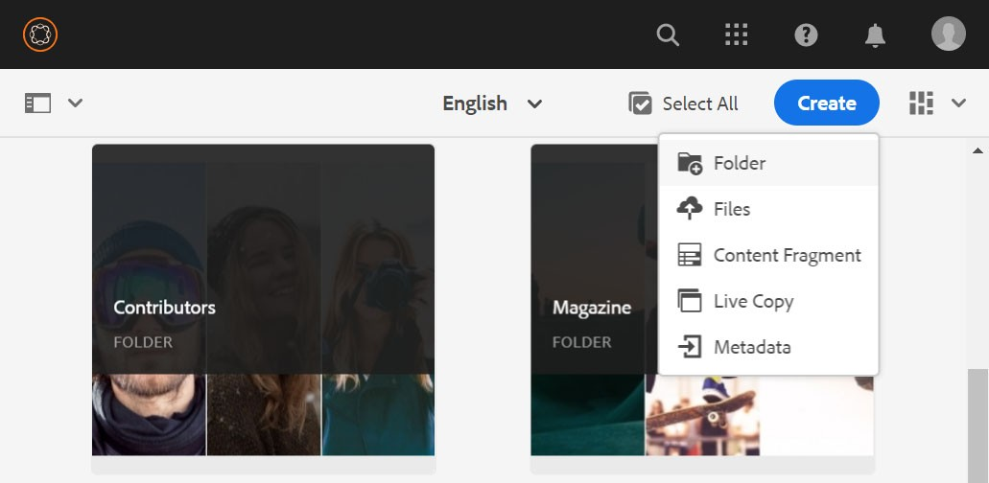



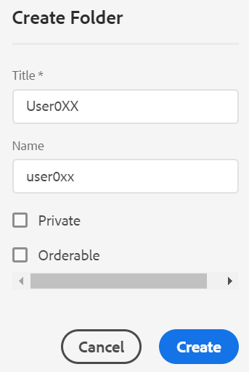

8/28/2020
Creating asset folders
1
Click the Create
2
button.
Select Folder from the drop- down list.
41
© 2020 Adobe. All Rights Reserved
41
ADOBE DIGITAL LEARNING SERVICES
Creating asset folders | Key fields
Key fields:
Title: A mandatory field displayed to the user
Name: An optional field to generate the Uniform Resource Identifier (URI)
o Name is derived from the title if not specified.
Best practice
Ensure that the Orderable check box is not selected in order to leave the folder unordered.
42
© 2020 Adobe. All Rights Reserved
42
ADOBE DIGITAL LEARNING SERVICES

Slide 22
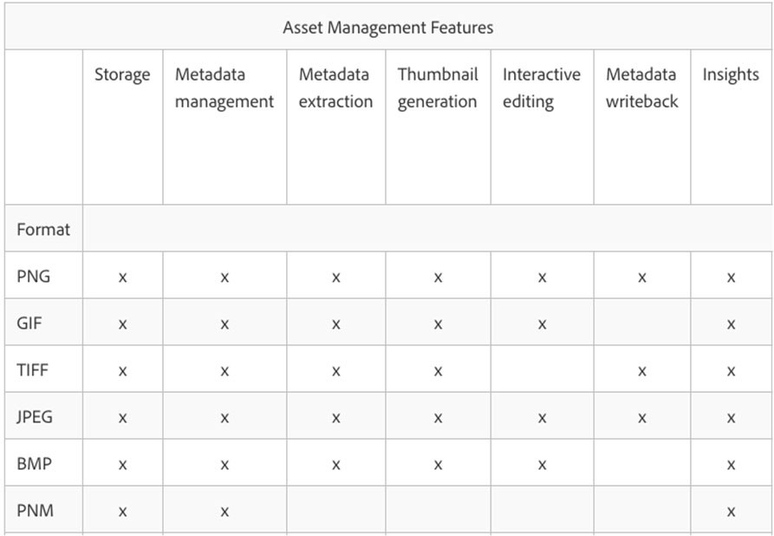
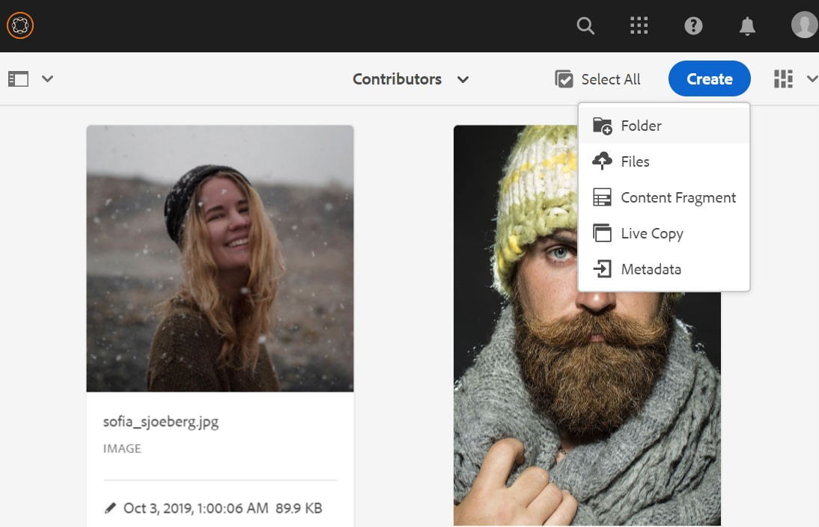
8/28/2020
Asset files and formats
See the full list on Helpx and Search:
AEM Assets supported formats
See the full list on Helpx and Search:
AEM Assets supported formats
43
© 2020 Adobe. All Rights Reserved
43
ADOBE DIGITAL LEARNING SERVICES
Uploading assets
Upload images, documents, and videos to the Assets console by using the:
Browser
Drag assets onto the folder
Assets Console
AEM Desktop App
44
© 2020 Adobe. All Rights Reserved
44
ADOBE DIGITAL LEARNING SERVICES

Slide 23


8/28/2020
Uploading assets | Resolving the same name issue
If an asset with the same name exists, you can:
Replace the existing asset.
o Metadata for the asset and the modifications are deleted.
Create another version of the asset.
Keep both assets by renaming the new asset that was uploaded.
Files with * / : [ \\ ] | # % { } ? & are converted into -
Upload files up to 2 GB
45
© 2020 Adobe. All Rights Reserved
45
ADOBE DIGITAL LEARNING SERVICES
Demo 1: Resolve a naming conflict
Scenario: As an asset manager, you uploaded a new version of an asset, which already exists in the AEM repository.
Demonstration
46
© 2020 Adobe. All Rights Reserved. Adobe Confidential.
46
ADOBE DIGITAL LEARNING SERVICES

Slide 24



8/28/2020
Exercise 1: Create a private folder and upload assets to the folder
Scenario: As an author, you need a set of images for creating webpages. You need to upload assets to a folder that only you can view.
In this exercise, you will create a private folder and upload assets to the folder.
Exercise
47
© 2020 Adobe. All Rights Reserved. Adobe Confidential.
47
ADOBE DIGITAL LEARNING SERVICES
Collections
A set of assets independent from the folder hierarchy
A set of references to assets, not the assets themselves
A collection can reference:
Assets
Folders
Other collections
48
© 2020 Adobe. All Rights Reserved
48
ADOBE DIGITAL LEARNING SERVICES

Slide 25
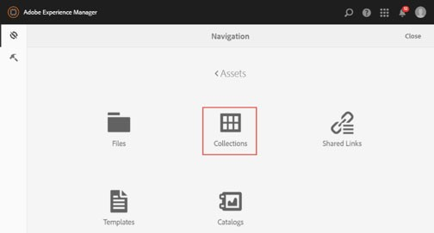
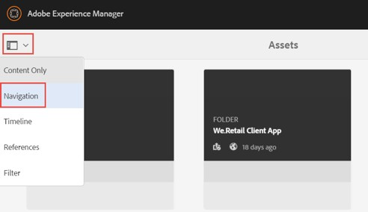
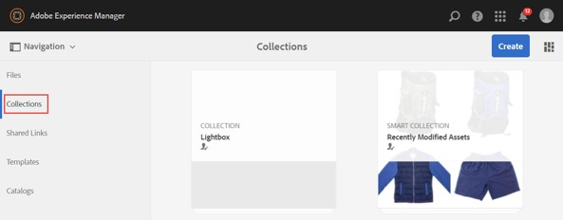
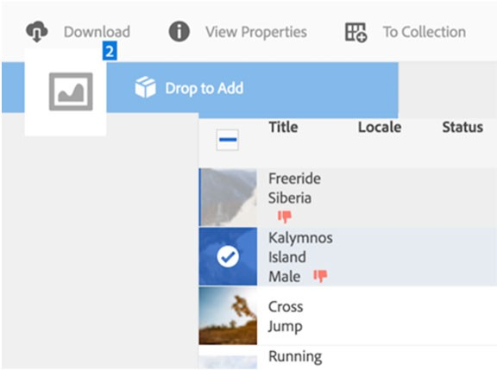
8/28/2020
Access the Collections console
Navigation > Assets > Collections
Left Rail > Navigation > Collections
49
© 2020 Adobe. All Rights Reserved
49
ADOBE DIGITAL LEARNING SERVICES
Lightbox
A special type of static collection
A user-specific collection
Temporary working set of references for quick access
Cannot be shared
Use case:
Make quick pre-selection when scanning through assets
Used with asset share pages
Drag and drop selected asset into lightbox
50
© 2020 Adobe. All Rights Reserved
50
ADOBE DIGITAL LEARNING SERVICES

Slide 26





8/28/2020
Exercise 2: Add assets to a Lightbox collections
Scenario: For future reference, you want to keep a list of images in AEM Assets that you personally like but do not have an immediate use for.
In this exercise, you will add some images to the lightbox.
Exercise
51
© 2020 Adobe. All Rights Reserved. Adobe Confidential.
51
ADOBE DIGITAL LEARNING SERVICES
Public and private collections
Public collections
Every AEM Digital Asset Manager (DAM) user can access collections
Private collections
Share user permissions to a collection with a set of DAM users or groups.
52
© 2020 Adobe. All Rights Reserved
52
ADOBE DIGITAL LEARNING SERVICES

Slide 27
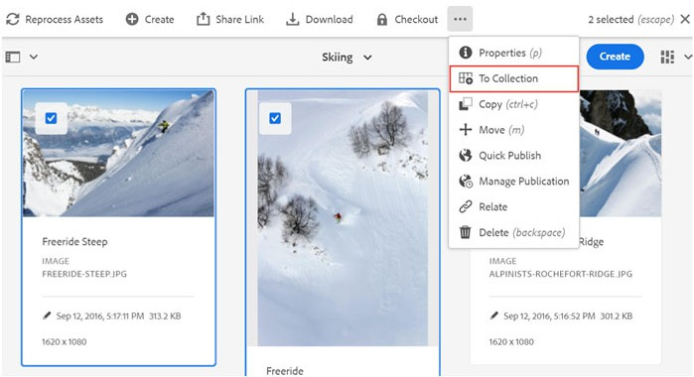
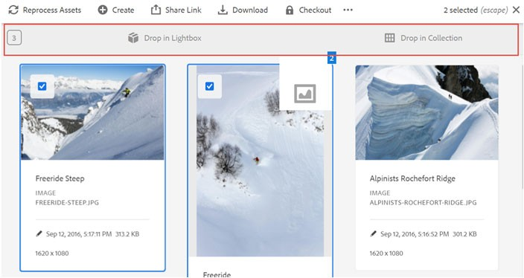


8/28/2020
Add assets to a collection
To Collection
Drop Zone
53
© 2020 Adobe. All Rights Reserved
53
ADOBE DIGITAL LEARNING SERVICES
Exercise 3: Create a collection with static references
Scenario: You want to create a collection of assets to share with your team members who do not have access to your private folders.
In this exercise, you will create a collection with static references by selecting images of shoes and clothes and add them to the Collections folder by using the drop zone.
Exercise
54
© 2020 Adobe. All Rights Reserved. Adobe Confidential.
54
ADOBE DIGITAL LEARNING SERVICES

Slide 28



8/28/2020
User permissions
User: A person or an external system connected to AEM
Permissions: The privileges assigned to a user to perform actions on a resource
Owner
Editor
Viewer
55
© 2020 Adobe. All Rights Reserved
55
ADOBE DIGITAL LEARNING SERVICES
Exercise 4: Enable user permissions for private folders
Scenario: You want a few of your team members to be able to edit assets, and you want other members to only view assets in your private folder.
In this exercise, you will enable the Editor and Viewer permissions for the private folder that you created in Exercise 1.
Exercise
56
© 2020 Adobe. All Rights Reserved. Adobe Confidential.
56
ADOBE DIGITAL LEARNING SERVICES

Slide 29


8/28/2020
Effective content hierarchies
The names of the folders should describe the content
Good names help:
Find assets
Search Engine Optimization
Content hierarchy planning is important.
57
© 2020 Adobe. All Rights Reserved
57
ADOBE DIGITAL LEARNING SERVICES
Reorganizing assets
Reorganize assets and folders by:
Reordering
Copying
Moving and Renaming
Sorting
Deleting
Example: Sort assets based on name
58
© 2020 Adobe. All Rights Reserved
58
ADOBE DIGITAL LEARNING SERVICES

Slide 30


8/28/2020
Exercise 5: Reorganize the assets within a folder
Scenario: As an author, you are working on a project and want to organize the required assets in a new folder.
In this exercise, you will reorganize the assets by using copy, sort, move, and delete options.
Exercise
59
© 2020 Adobe. All Rights Reserved. Adobe Confidential.
59
ADOBE DIGITAL LEARNING SERVICES
Download assets and folders
Download assets and folder
To your computer
Send by email
Limitations:
Max 1 GB per download
Max 500 files per download
60
© 2020 Adobe. All Rights Reserved
60
ADOBE DIGITAL LEARNING SERVICES

Slide 31



8/28/2020
Exercise 6: Download an asset folder to your local file system
Scenario: You want to download the assets you are currently working on to your local system.
In this exercise, you will download assets to your computer by using the Download option.
Exercise
61
© 2020 Adobe. All Rights Reserved. Adobe Confidential.
61
ADOBE DIGITAL LEARNING SERVICES
The Assets console of AEM helps import, manage, and share digital assets across different channels.
AEM supports text, image, video, and audio asset formats.
You can organize assets by using folders and collections.
You can upload assets to a folder by:
Using the Assets console
Dragging assets
Using the AEM Desktop App
Key Takeaways
62
© 2020 Adobe. All Rights Reserved. Adobe Confidential.
62
ADOBE DIGITAL LEARNING SERVICES

Slide 32

8/28/2020
Managing Assets Metadata
Agenda: Assets metadata Edit the assets metadata Export and import the asset metadata Create a metadata profile and apply it to an asset folder Relate and unrelate assets Creating and managing tags Tag assets Smart tags
63
Overview of metadata
Metadata means data about data
Common metadata properties:
Asset name
Last modified
Asset creation date
Asset size
MIME type (image/png, application/pdf)
Descriptive metadata properties:
Owner
Title
Description
Copyright
Keywords
64
© 2020 Adobe. All Rights Reserved
64
ADOBE DIGITAL LEARNING SERVICES

Slide 33


8/28/2020
Importance of metadata
Metadata
Increases the value of an asset
Is easier to expose and remove old and unused assets
Reduces the Digital Asset Management (DAM) size
Reduces the dark assets
Gives users a richer set of assets
Relevant metadata is:
More accessible
Easier to manage
More complex
65
© 2020 Adobe. All Rights Reserved
65
ADOBE DIGITAL LEARNING SERVICES
Asset properties
66
© 2020 Adobe. All Rights Reserved
66
ADOBE DIGITAL LEARNING SERVICES

Slide 34













8/28/2020
Metadata schemas
Can be viewed under Asset properties
Can be read or read/write
AEM supports:
Default – standard metadata for all assets
Image – image specific metadata
o JPEG
o PNG
Application
o PDF
Video
Collection, Content Fragment, Forms – unique asset types to AEM
67
© 2020 Adobe. All Rights Reserved
67
ADOBE DIGITAL LEARNING SERVICES
Asset property groups
a
Common metadata and references for the asset
a b
c
d
e
f
b
Digital rights management, collaborative rating, and promotion keywords
c
A standard that Adobe products and others use creatively
d
Information about the camera and the shot details
e
Common metadata and references for the asset
f
Captured by Adobe Analytics
68
© 2020 Adobe. All Rights Reserved
68
ADOBE DIGITAL LEARNING SERVICES

Slide 35


8/28/2020
Editing bulk asset properties
In Bulk editing, you can:
Select multiple assets and add common properties
Update values in the fields
New values are applied to all the selected assets
Append a new value or remove a common value
69
© 2020 Adobe. All Rights Reserved
69
ADOBE DIGITAL LEARNING SERVICES
Exercise 1: Edit the assets metadata
Scenario: After uploading assets to the AEM assets folder, you realized that you need to organize the assets. You need to add the metadata for the assets so that AEM can easily organize the assets.
In this exercise, you will edit the metadata of an asset.
Exercise
70
© 2020 Adobe. All Rights Reserved. Adobe Confidential.
70
ADOBE DIGITAL LEARNING SERVICES

Slide 36



8/28/2020
Export and import metadata
Export asset metadata and modify it externally
Export first to have a metadata template
Folder export only
o Optionally include subfolders
Schedule large exports/imports
In/out as a CSV
Imports can be configured
71
© 2020 Adobe. All Rights Reserved
71
ADOBE DIGITAL LEARNING SERVICES
Metadata jobs
Export and import jobs processed in the Assets > Jobs console
Download exports and view job status
72
© 2020 Adobe. All Rights Reserved
72
ADOBE DIGITAL LEARNING SERVICES

Slide 37

8/28/2020
Exercise 2: Export and import asset metadata
Scenario: You want to edit the metadata for a large number of assets that you uploaded to AEM. You need to export the metadata, edit the metadata in the CSV file, and import the metadata to AEM.
Tasks to perform:
Export metadata
Import metadata
Exercise
73
© 2020 Adobe. All Rights Reserved. Adobe Confidential.
73
ADOBE DIGITAL LEARNING SERVICES
Metadata profiles
Apply default metadata to newly uploaded assets within a folder
Default values are applied to:
Assets uploaded
One or more folders and subfolders
Metadata Profiles console:
Tools > Assets > Metadata Profiles
Create/Copy Metadata Profiles
74
© 2020 Adobe. All Rights Reserved
74
ADOBE DIGITAL LEARNING SERVICES

Slide 38



8/28/2020
Apply metadata profiles
Metadata Profiles Console
Asset Properties > Metadata Profiles
75
© 2020 Adobe. All Rights Reserved
75
ADOBE DIGITAL LEARNING SERVICES
Exercise 3: Create a metadata profile and apply it to an asset folder
Scenario: Instead of adding metadata values to each asset manually, you want to apply the metadata values to a folder so that whenever you upload assets to the folder, it inherits the metadata values by default.
In this exercise, you will create a metadata profile and apply the metadata profile to an asset folder.
Exercise
76
© 2020 Adobe. All Rights Reserved. Adobe Confidential.
76
ADOBE DIGITAL LEARNING SERVICES

Slide 39



8/28/2020
Relate and unrelate assets
Relate assets manually with other assets that share common attributes:
For example: A license file with an asset or an image/video
Create source/derived relationships between assets
For example: Relate a PDF file to its source INDD file
77
© 2020 Adobe. All Rights Reserved
77
ADOBE DIGITAL LEARNING SERVICES
Relate and unrelate assets | Location
Actions Bar
Properties
78
© 2020 Adobe. All Rights Reserved
78
ADOBE DIGITAL LEARNING SERVICES

Slide 40


8/28/2020
Relate suboptions
The Source option creates a two-way relationship with other resources.
The Derived option relates the asset with a derived file.
The Other option relates the asset with the source file of the asset.
79
© 2020 Adobe. All Rights Reserved
79
ADOBE DIGITAL LEARNING SERVICES
Viewing related assets
Basic tab > Related section
80
© 2020 Adobe. All Rights Reserved
80
ADOBE DIGITAL LEARNING SERVICES

Slide 41

8/28/2020
Exercise 4: Relate and unrelate assets
Scenario: You uploaded an asset to AEM and want to link an image with the asset for future reference. For this, you need to relate the image with the asset.
In this exercise, you will add an image as the reference of an asset and then relate and unrelate the assets.
Exercise
81
© 2020 Adobe. All Rights Reserved. Adobe Confidential.
81
ADOBE DIGITAL LEARNING SERVICES
Tags
Are a piece of metadata assigned to an asset
Classify content quickly and easily within a website
Maximize searches to find the related content
Can be centrally managed by a Tag Administrator
82
© 2020 Adobe. All Rights Reserved
82
ADOBE DIGITAL LEARNING SERVICES

Slide 42



8/28/2020
Tagging console
Create and manage tags and their taxonomies
Tools > General > Tagging
Only users added to the
tag-administrators group can use this console.
83
© 2020 Adobe. All Rights Reserved
83
ADOBE DIGITAL LEARNING SERVICES
Manage tags
Namespaces
Categorize a group of tags
Organize tags hierarchically
Properties
Displays the name, the time of the last edit, and the number of references
References
Displays the number of references to the tag or namespace
Are the list of content paths with tags applied
84
© 2020 Adobe. All Rights Reserved
84
ADOBE DIGITAL LEARNING SERVICES

Slide 43


8/28/2020
Actions on tags
Actions | Description
Create Tag | Adds a child tag to the current tag
Edit | Edits the title and description of a namespace or a tag
Move | Moves the tag to a new location or renames it
Merge | Merges the tags of one namespace to another and is useful for duplicate tags
Publish | Publishes the tag in the publish service
Unpublish | Unpublishes the tag in publish service but still exists on the author service
Delete | Removes the tag (and all references) from the author service
85
© 2020 Adobe. All Rights Reserved
85
ADOBE DIGITAL LEARNING SERVICES
Adding tags to assets
Add tags from:
Properties
Manage Tags
86
© 2020 Adobe. All Rights Reserved
86
ADOBE DIGITAL LEARNING SERVICES

Slide 44

8/28/2020
Exercise 5: Tag assets in AEM
Scenario: As an author, you uploaded assets to AEM. You want to be able to tag the assets with specific managed tags. A Tag administrator needs to create these tags so they can be applied to the assets for easy searching in the future.
Tasks to perform:
Create a tag
Add tags to assets
Exercise
87
© 2020 Adobe. All Rights Reserved. Adobe Confidential.
87
ADOBE DIGITAL LEARNING SERVICES
Smart tags
Powered by Adobe Sensei
Augment the search capabilities of AEM
Auto-tags image assets with relevant tags
Exposes dark assets with relevant search terms
Can be configured to:
Be relevant to your assets
Use your tag taxonomy (enhanced smart tags)
88
© 2020 Adobe. All Rights Reserved
88
ADOBE DIGITAL LEARNING SERVICES

Slide 45


8/28/2020
Manage smart tags
Manage smart tags from the Manage Tags page to :
Delete the irrelevant smart tags
Promote the relevant tags
Add the managed tags
Reset manual work
89
© 2020 Adobe. All Rights Reserved
89
ADOBE DIGITAL LEARNING SERVICES
Enable smart tags
Smart tags service auto-configured in AEM as a Cloud Service
Enable Smart tags per folder
Select the Enable Smart Tags option in Folder Properties
Applied to all subfolders
90
© 2020 Adobe. All Rights Reserved
90
ADOBE DIGITAL LEARNING SERVICES

Slide 46
8/28/2020
AEM can categorize, organize, and search for assets based on the metadata properties of an asset.
Metadata can be technical and descriptive.
You can view metadata from the Properties page.
You can import and export metadata by using a CSV file.
The metadata profile helps apply default metadata to the assets within a folder.
You can relate the assets that share common attributes with its source, derived, and other resources.
You can create tags and taxonomies to help classify the content within a website.
Key Takeaways
91
© 2020 Adobe. All Rights Reserved. Adobe Confidential.
91
ADOBE DIGITAL LEARNING SERVICES
Managing Assets
Agenda: Asset renditions Options to edit images Working collaboratively Add annotations to an asset Create an asset version Asset sharing methods Share an asset by using the Share Link option Publish and unpublish assets
92

Slide 47








8/28/2020
Asset renditions
Renditions:
Are additional representations of the image or video files
Enable you to create multiple views of the asset
Are auto-generated
Add, view, and delete asset renditions from the
Renditions panel
93
© 2020 Adobe. All Rights Reserved
93
ADOBE DIGITAL LEARNING SERVICES
Editing images
Start Crop: Crops an image based on various aspect ratios available by default.
Rotate Left/Right: Rotates an image clockwise or counterclockwise
Flip Horizontal/Vertical: Flips the image horizontally or vertically
Launch Map: Adds one or more hyperlinked areas to the image
94
© 2020 Adobe. All Rights Reserved
94
ADOBE DIGITAL LEARNING SERVICES

Slide 48


8/28/2020
Working in collaboration
Annotations
Asset Versioning
95
© 2020 Adobe. All Rights Reserved
95
ADOBE DIGITAL LEARNING SERVICES
Annotations
Are comments or explanatory notes that you can add to assets, such as images and videos
Help reviewers and marketers add comments and feedback about assets
Help creative practitioners collaborate with reviewers and marketers
Resize the image – John Martin
96
© 2020 Adobe. All Rights Reserved
96
ADOBE DIGITAL LEARNING SERVICES

Slide 49






8/28/2020
Adding annotations to assets
Quick Actions
Actions Bar
Timeline
Asset Details Page
97
© 2020 Adobe. All Rights Reserved
97
ADOBE DIGITAL LEARNING SERVICES
Viewing, printing, and downloading saved annotations
View and print the saved annotations to PDF from the Timeline panel
Download the PDF to your local system
View annotations Print annotations
98
© 2020 Adobe. All Rights Reserved
98
ADOBE DIGITAL LEARNING SERVICES

Slide 50

8/28/2020
Modifying the annotation color
Differentiate annotation for users
Choose color from the Annotation Color section
99
© 2020 Adobe. All Rights Reserved
99
ADOBE DIGITAL LEARNING SERVICES
Exercise 1: Add annotations to an asset
Scenario: As an author, you want to add comments on the assets that need to be edited later. You also want to view the annotations that you added and save a hardcopy of the annotations for future reference.
Tasks to perform:
Add annotations to an asset
View annotations added to an asset
Print annotations on a page
Exercise
100
© 2020 Adobe. All Rights Reserved. Adobe Confidential.
100
ADOBE DIGITAL LEARNING SERVICES

Slide 51



8/28/2020
Assets versioning
Versioning creates a snapshot of digital assets at a specific point in time.
In AEM, you can:
Create an asset version
Restore the previous asset version
Compare image asset versions
Preview the asset version
101
© 2020 Adobe. All Rights Reserved
101
ADOBE DIGITAL LEARNING SERVICES
Creating asset versions manually
To create an asset version, click:
Create > Version
Timeline > Save as Version
Actions bar
Left Rail
102
© 2020 Adobe. All Rights Reserved
102
ADOBE DIGITAL LEARNING SERVICES

Slide 52


8/28/2020
Auto-create asset versions
Asset versions are auto-created when the asset is:
Published
Edited in the browser
Modified by an external program like the Desktop App
103
© 2020 Adobe. All Rights Reserved
103
ADOBE DIGITAL LEARNING SERVICES
Restoring, comparing, and previewing asset versions
After creating asset versions, you can:
Revert to a prior version by using the Revert to this Version option
Compare the current and the previous version of the asset and view the changes
Generate the preview of an asset version by using the Preview Version option
104
© 2020 Adobe. All Rights Reserved
104
ADOBE DIGITAL LEARNING SERVICES

Slide 53



8/28/2020
Exercise 2: Create an asset version
Scenario: After editing an asset, you want to save the asset with a new version. You name it as version 2.0. However, you decide to use the previous asset version as per your requirement.
In this exercise, you will edit an asset, create a new asset version, and then restore the asset to its previous asset version.
Exercise
105
© 2020 Adobe. All Rights Reserved. Adobe Confidential.
105
ADOBE DIGITAL LEARNING SERVICES
Share link
Share assets, folders, and collections as a URL with members of your organization and external entities
The Share Link option appears on the actions bar
Link expires in 7 days by default
106
© 2020 Adobe. All Rights Reserved
106
ADOBE DIGITAL LEARNING SERVICES

Slide 54



8/28/2020
Share link | Benefits
Benefits of using Share Link:
Increased content process velocity
External parties can access assets without logging in to AEM Assets
Share assets easily with different external collaborators
107
© 2020 Adobe. All Rights Reserved
107
ADOBE DIGITAL LEARNING SERVICES
Exercise 3: Share an asset by using the Share Link option
Scenario: You are working for an e-commerce website and as a creative person, you want to share assets with the external authors working on the website.
In this exercise, you will share an asset by using the Share Link option.
Exercise
108
© 2020 Adobe. All Rights Reserved. Adobe Confidential.
108
ADOBE DIGITAL LEARNING SERVICES

Slide 55


8/28/2020
Publishing and unpublishing assets
Publish one or more assets to the Publish instance
Unpublish assets from the Publish instance
Publish/Unpublish Now: Publishes asset immediately
Publish later/Unpublish Later: Schedules publishing for later
109
© 2020 Adobe. All Rights Reserved
109
ADOBE DIGITAL LEARNING SERVICES
Exercise 4: Publish and unpublish an asset
Scenario: After collating all image assets, you want to make the assets available to your stakeholders working on various projects. You also want to unpublish the assets after a specific time.
In this exercise, you will publish and unpublish an asset immediately and later.
Exercise
110
© 2020 Adobe. All Rights Reserved. Adobe Confidential.
110
ADOBE DIGITAL LEARNING SERVICES

Slide 56
8/28/2020
Renditions are representations of assets auto-created in different dimensions.
You can crop, rotate, flip, and add a hotspot to images.
You can annotate assets to provide comments on assets.
You can restore an asset to its previous state by using versions.
You can share assets by using:
Asset Share Link
Publish/Unpublish Assets
Brand Portal
Asset Share Commons
Asset Share Link helps share assets with external parties, so that they can access the assets without logging in to AEM
Assets.
Publish and unpublish assets help make assets available and unavailable, respectively, for the website visitors.
Key Takeaways
111
© 2020 Adobe. All Rights Reserved. Adobe Confidential.
111
ADOBE DIGITAL LEARNING SERVICES
Searching Assets
Agenda: AEM search functionality Find assets by using full text search Refine your search with filters Saving searches Create a smart collection to save the search filters Search promote Add a search promote keyword to an asset
112

Slide 57


8/28/2020
Search assets
Fulltext and filtered
Saved searches
Wildcard support * ?
Multi-facet search support
Highly customizable
113
© 2020 Adobe. All Rights Reserved
113
ADOBE DIGITAL LEARNING SERVICES
Search types
Full text
Keywords, metadata
Managed tags and Smart Tags
Document text
Wildcard support
Filtered
File type, asset status, size, and orientation
Load saved searches
Insights
Adobe Stock info
114
© 2020 Adobe. All Rights Reserved
114
ADOBE DIGITAL LEARNING SERVICES

Slide 58





8/28/2020
Additional search functionalities
Search for an asset and navigate back to the same position in search results
View the default search order criteria and use multiple options to sort the search results
Filter search results based on granular file types, such as .jpg, .png, and .psd
Search for folders and view the count in search results
Filter search results based on accurate time stamps
115
© 2020 Adobe. All Rights Reserved
115
ADOBE DIGITAL LEARNING SERVICES
Exercise 1: Find assets by using full text search
Scenario: As an author, you need a class of images to use in creating a webpage. You can search for the images based on the tags you used for the images.
In this exercise, you will search for assets by using full text search.
Exercise
116
© 2020 Adobe. All Rights Reserved. Adobe Confidential.
116
ADOBE DIGITAL LEARNING SERVICES

Slide 59

8/28/2020
Exercise 2: Refine your search with filters
Scenario: You are working on a project and need a set of assets that were recently modified but not published.
In this exercise, you will search for assets based on the following criteria:
Folder
File type
Last modified
Status
Exercise
117
© 2020 Adobe. All Rights Reserved. Adobe Confidential.
117
ADOBE DIGITAL LEARNING SERVICES
Saved search or smart collection
Define and save searches based on resource-specific criteria:
File type
File size
Last modified
Also called a smart collection
Smart collections can only be created with files and not with folders
118
© 2020 Adobe. All Rights Reserved
118
ADOBE DIGITAL LEARNING SERVICES

Slide 60

8/28/2020
Exercise 3: Create a smart collection to save the search filters
Scenario: After searching for a set of images, you need to save the search criteria as a smart collection for future use.
In this exercise, you will create a smart collection from the search results page.
Exercise
119
© 2020 Adobe. All Rights Reserved. Adobe Confidential.
119
ADOBE DIGITAL LEARNING SERVICES
Search promote
Helps
Assign keywords and phrases to assets
Display assets with specific keywords at the top of the search results
Assign keywords from
Properties > Advanced > Elevate for search keywords
120
© 2020 Adobe. All Rights Reserved
120
ADOBE DIGITAL LEARNING SERVICES

Slide 61
8/28/2020
Exercise 4: Add a search promote keyword to an asset
Scenario: You want to increase the search relevance of certain assets so that they appear on top of the search results.
In this exercise, you will edit the metadata of assets, add the search promote keyword, and view the search result.
Exercise
121
© 2020 Adobe. All Rights Reserved. Adobe Confidential.
121
ADOBE DIGITAL LEARNING SERVICES
The search feature displays the assets whose metadata exactly matches the corresponding value.
You can filter searches by file type, file size, last modified, publish status, orientation, style, and insights.
You can search for content in AEM by using the / key.
You can save search results and criteria as a smart collection.
The Search Promote option helps assign keywords and phrases to assets to increase the search relevancy.
Key Takeaways
122
© 2020 Adobe. All Rights Reserved. Adobe Confidential.
122
ADOBE DIGITAL LEARNING SERVICES

Slide 62

8/28/2020
Creating Review Tasks and Workflows
Agenda: Review tasks Create a review task Workflows in Adobe Experience Manager (AEM) Navigate through the Workflow console List the workflow steps Delete an asset by using a workflow Create a workflow to publish multiple assets Publish multiple assets by using workflows
123
Reviewing tasks
Seek feedback on assets by setting up an ad-hoc review workflow for assets within a folder
Associate the review workflow with a project or create an independent review task
Create a review task by using the Create Review Task option
124
© 2020 Adobe. All Rights Reserved
124
ADOBE DIGITAL LEARNING SERVICES

Slide 63

8/28/2020
Asset review process | Steps
The reviewer receives a notification with a link to the review folder.
The reviewer can access the task from the Inbox.
The reviewer can either approve or reject the assets, request changes, and annotate or compare the assets in the folder.
Notifications are sent to the intended recipients regarding the completion of tasks at various stages.
125
© 2020 Adobe. All Rights Reserved
125
ADOBE DIGITAL LEARNING SERVICES
Exercise 1: Create a review task for an asset folder
Scenario: You are working for a travel agency and creating a webpage that displays all types of clothes that one must carry for an adventure trip. This involves uploading multiple images to Adobe Experience Manager (AEM). You want to send the assets for review to one of your team members before publishing the webpage. For this, you can create a workflow for reviewing the asset folders.
In this exercise, you will create a review task for an asset folder, assign the task to yourself, and approve or reject the assets of the folder.
Exercise
126
© 2020 Adobe. All Rights Reserved. Adobe Confidential.
126
ADOBE DIGITAL LEARNING SERVICES

Slide 64



8/28/2020
Workflows in AEM | An overview
Enable you to automate AEM activities
Example: Steps to create and publish assets with sign- off tasks
Execute a series of steps in a specific order
Each step performs a distinct activity, such as activating an asset.
Use the predefined workflow models
Create custom workflow models based on the specific needs
127
© 2020 Adobe. All Rights Reserved
127
ADOBE DIGITAL LEARNING SERVICES
Start a workflow instance manually
Timeline
Create > Workflow
128
© 2020 Adobe. All Rights Reserved
128
ADOBE DIGITAL LEARNING SERVICES
128

Slide 65




8/28/2020
User inbox
View tasks, work items, and notifications assigned to you
129
© 2020 Adobe. All Rights Reserved
129
ADOBE DIGITAL LEARNING SERVICES 129
Moving a workflow process forward
Execute tasks
Open: Open the task description
Payload: View relevant content
Move the tasks to the next stage
Complete: Mark the task as finished
Step back: Send the task back to the previous participant
Delegate: Assign the task to another user in the team
130
© 2020 Adobe. All Rights Reserved
130
ADOBE DIGITAL LEARNING SERVICES
130

Slide 66

8/28/2020
Exercise 2: Use a workflow to delete an asset
Scenario: As a reviewer, you want to delete the assets that are not relevant in a collection.
In this exercise, you will use the Request for Deletion workflow model to delete an asset from the repository. The Request for Deletion workflow does not allow you to delete assets randomly.
Exercise
131
© 2020 Adobe. All Rights Reserved. Adobe Confidential.
131
ADOBE DIGITAL LEARNING SERVICES
Workflow console
A centralized location for managing workflows
Tools > Workflow
132
© 2020 Adobe. All Rights Reserved
132
ADOBE DIGITAL LEARNING SERVICES
132

Slide 67













8/28/2020
Workflow console | Options
Models: Helps create, edit, or delete workflows.
Archive: Displays the completed and terminated workflow instances. The Open History option displays the history of the workflow instance.
Instance: Displays the details of active workflow instances and help terminate, suspend, rename, and open the history of the workflow instance.
Failures: Monitors and manages failed workflow instances. It provides the terminate and retry steps to complete the workflow steps.
Launchers: Defines whether a workflow should be launched when a specific event occurs in AEM.
Auto-Assign: Configures auto-assigning workflows to templates
133
© 2020 Adobe. All Rights Reserved
133
ADOBE DIGITAL LEARNING SERVICES
Examples of workflow steps
Participant
OR Split
Process
AND Split
Create task
Dynamic participant
Form participant
134
© 2020 Adobe. All Rights Reserved
134
ADOBE DIGITAL LEARNING SERVICES

Slide 68

8/28/2020
Workflow model editor
Drag-and-drop
Configure
Customize
135
© 2020 Adobe. All Rights Reserved
135
ADOBE DIGITAL LEARNING SERVICES 135
Exercise 3: Create a workflow to publish multiple assets (Optional)
Scenario: As a project manager, you require one of your team members to publish multiple assets to a webpage. To do so, you want to create a workflow.
Tasks to perform:
Create a workflow model
Add a participant step and assign a user
Add a process step to publish assets
Exercise
136
© 2020 Adobe. All Rights Reserved. Adobe Confidential.
136
ADOBE DIGITAL LEARNING SERVICES

Slide 69
8/28/2020
Exercise 4: Publish multiple assets by using a workflow
Scenario: You want to use a workflow to publish multiple assets.
In this exercise, you will use the out-of-the-box Publish Example workflow. You can also use the User0XX_Request for Publishing workflow, created in Exercise 3, to publish multiple assets.
Exercise
137
© 2020 Adobe. All Rights Reserved. Adobe Confidential.
137
ADOBE DIGITAL LEARNING SERVICES
You can seek review feedback on assets by creating an ad-hoc review workflow for assets.
Workflows involve a series of steps, and each step performs a specific task.
AEM provides several tools for creating workflow models, developing workflow steps, and interacting with workflows.
Each step in a workflow can contain any number of actions and associated conditions.
You can start the workflow from the Assets console, the Timeline panel, and the Workflow console.
You can complete, step back, and delegate tasks from the Inbox.
Key Takeaways
138
© 2020 Adobe. All Rights Reserved. Adobe Confidential.
138
ADOBE DIGITAL LEARNING SERVICES

Slide 70






8/28/2020
Creating and Managing Projects
Agenda: Projects in Adobe Experience Manager (AEM) Actions you can perform on projects Project life cycle Create a project and add tiles to it Start a project workflow and run through the associated tasks
139
Projects | An overview
Help group resources into one entity
Help associate resources with a project – tiles
140
© 2020 Adobe. All Rights Reserved
140
ADOBE DIGITAL LEARNING SERVICES 140

Slide 71


8/28/2020
Projects console
Access and manage projects within AEM
141
© 2020 Adobe. All Rights Reserved
141
ADOBE DIGITAL LEARNING SERVICES 141
Project template
Authors can choose from out-of-the box project templates.
Developers can:
Create custom project templates
Configure the project dashboard
Use custom workflows
Create additional business roles for a project
142
© 2020 Adobe. All Rights Reserved
142
ADOBE DIGITAL LEARNING SERVICES
142

Slide 72

8/28/2020
Project roles
Roles | Description | Permissions
Observer | View project details, including the project status. | Read-only permissions on a project.
Editor | Upload and edit the contents of a project. | Read and Write access on a project, associated metadata, and related assets.
Owner | Create a project, initiate work in a project, move approved assets to the Production folder and view and perform all other tasks in the project | Modify permission(s) on a specific project.
143
© 2020 Adobe. All Rights Reserved
143
ADOBE DIGITAL LEARNING SERVICES
Project tiles
Associate different tiles with your project from the Project console
Provide default tiles– Team, Assets, and Workflows tiles
Add different tiles to the project by clicking Add from the Actions Bar
144
© 2020 Adobe. All Rights Reserved
144
ADOBE DIGITAL LEARNING SERVICES

Slide 73











8/28/2020
Performing actions on projects
Create a project
Add experiences to a project
Add members to a pr
oject
Add workflows to a project
Add tiles to a proje
ct
Complete tasks assigned to a project
Track project progr
ess
Make projects inactive
Edit tiles of a project
145
© 2020 Adobe. All Rights Reserved
145
ADOBE DIGITAL LEARNING SERVICES
Use case | New product project: challenge
Scenario: A project manager wants to kick off a project to add a new product into the production assets, so that it can be used on the website, print materials, and their mobile applications.
Product image assets
Production assets folder
146
© 2020 Adobe. All Rights Reserved
146
ADOBE DIGITAL LEARNING SERVICES
146

Slide 74




8/28/2020
Use case | New product project: solution
Solution: The project manager can use AEM Projects to:
Dynamically add Creative Designers and Reviewers roles to the project
Assign work to the Creative Designers and Reviewers through workflows
Monitor the progress of all the work given to the team
Progress check
Creative Designer
Reviewer
147
© 2020 Adobe. All Rights Reserved
147
ADOBE DIGITAL LEARNING SERVICES 147
Use case | New product project roles
Project Manager (owner)
Creative Designer (designer)
Reviewer (reviewers)
AEM Asset Author (editor)
148
© 2020 Adobe. All Rights Reserved
148
ADOBE DIGITAL LEARNING SERVICES
148

Slide 75

8/28/2020
Exercise 1: Create a project and add tiles to it
In this exercise, you will create a project and view the private folder created in the sandbox where you can upload work-in-progress assets.
Exercise
149
© 2020 Adobe. All Rights Reserved. Adobe Confidential.
149
ADOBE DIGITAL LEARNING SERVICES
Project workflows
Special task-based workflow
Tasks can have start/end dates and priority
Specific to a custom project
Can be assigned to a member or group
UI for project management
150
© 2020 Adobe. All Rights Reserved
150
ADOBE DIGITAL LEARNING SERVICES
150

Slide 76





8/28/2020
Use case | New product project process
Scenario: The project workflow includes the following steps:
Uploading new raw product photos into a sandbox location in AEM Assets.
Editing and removing any duplicate photos after the photos are uploaded by a creative designer.
Reviewing and approving the photos for production. In this step,
If the photos are incorrect, the creative designer needs to be notified with a proper feedback loop.
If the photos are approved, an AEM author needs to move the approved assets into the production location.
Upload assets
Edit and remove duplicate assets
Review and approve assets
151
© 2020 Adobe. All Rights Reserved
151
ADOBE DIGITAL LEARNING SERVICES 151
Use case | New product project workflow
1. Project start (Project Manager)
2. Upload and retouch (Creative Designer)
3. Review and approve (Reviewers)
3. (a) Move approved photos to production (AEM Author )
3. (b) Move rejected photos to Creative Designer
152
© 2020 Adobe. All Rights Reserved
152
ADOBE DIGITAL LEARNING SERVICES
152

Slide 77
8/28/2020
Exercise 2: Start a project workflow and review the associated tasks
In this exercise, you will start a project workflow and review the workflow within the project.
Exercise
153
© 2020 Adobe. All Rights Reserved. Adobe Confidential.
153
ADOBE DIGITAL LEARNING SERVICES
Projects help you group resources into one entity.
You can access and manage projects in AEM from the Projects console.
Project workflows consist of a series of steps that are executed in a specific order.
You can use preconfigured project templates or create custom project templates.
From the Projects console, you can:
Create a project and add members to the project
Add and edit tiles in a project
Add experiences to a project
Add workflows to a project
Complete tasks assigned to a project
Track project progress
Make projects inactive
Key Takeaways
154
© 2020 Adobe. All Rights Reserved. Adobe Confidential.
154
ADOBE DIGITAL LEARNING SERVICES

Slide 78

8/28/2020
Working with Creative Tools
Agenda: Adobe Stock Adobe Asset Link Adobe Experience Manager (AEM) Desktop App Install the AEM Desktop App on your system Map the AEM author instance with AEM Desktop App Enable desktop actions for assets Actions you can perform on assets Upload a folder of assets to AEM Check out and edit an asset
155
Adobe Stock Access all licensed assets in Adobe Stock directly from the AEM Assets user interface
Search and preview assets Copy and publish assets Share assets on Brand Portal Access and use assets by using the AEM Desktop App
© 2020 Adobe. All Rights Reserved 156 ADOBE DIGITAL LEARNING SERVICES
156

Slide 79








8/28/2020
Adobe Assets link
Discover
Search for assets across AEM Assets and the Creative Cloud account
Access folders and collections in AEM Assets
Visual search for the assets in AEM Assets powered by Adobe Sensei
Use
Preview assets, key metadata, and versions
View the assets licensed from Adobe Stock in AEM
Download and open an asset locally as a copy
Embed assets into the designs
Edit and Collaborate
Check out and check in content to prevent duplicate work and retain a single source file
Keep work-in-progress assets and final production assets in separate locations
157
© 2020 Adobe. All Rights Reserved
157
ADOBE DIGITAL LEARNING SERVICES
Adobe Assets link
Upload
Upload a file that is opened in a Creative Cloud application directly to AEM
Provide versioning comments
Efficiency
Perform Single sign-on with Creative Cloud credentials to access assets from AEM
Optimize available network bandwidth
Access Creative Cloud Packager support directly in the Admin Console
158
© 2020 Adobe. All Rights Reserved
158
ADOBE DIGITAL LEARNING SERVICES

Slide 80




8/28/2020
AEM Desktop App
Map the AEM Assets repository to a network directory on your computer
View and browse assets in AEM using Mac OS X Finder or Windows Explorer
Create, edit, and delete the assets from Finder/Explorer
Synchronize any changes to assets from Finder/Explorer within AEM Assets
159
© 2020 Adobe. All Rights Reserved
159
ADOBE DIGITAL LEARNING SERVICES
Connecting AEM assets with the Desktop App
File Browser
Desktop Application
Adobe Experience Manager Desktop App
Adobe Experience Manager Assets
160
© 2020 Adobe. All Rights Reserved
160
ADOBE DIGITAL LEARNING SERVICES

Slide 81


8/28/2020
Connecting AEM Assets with the Desktop App
Download the Desktop App.
Install the Desktop App.
Map the Desktop App with AEM Assets as a local file system (drive).
New drive in file explorer
AEM Assets
161
© 2020 Adobe. All Rights Reserved
161
ADOBE DIGITAL LEARNING SERVICES
Exercise 1: Install the AEM Desktop App on your system
In this exercise, you will install AEM Desktop App on your system.
You can download the latest Desktop app from the Adobe Experience Manager desktop app release notes page.
Exercise
162
© 2020 Adobe. All Rights Reserved. Adobe Confidential.
162
ADOBE DIGITAL LEARNING SERVICES

Slide 82


8/28/2020
Exercise 2: Map the AEM author service with the AEM Desktop App
Scenario: You want to work on the AEM Desktop App. You need to first connect the AEM Desktop App with the AEM authoring instance you are working on.
Exercise
163
© 2020 Adobe. All Rights Reserved. Adobe Confidential.
163
ADOBE DIGITAL LEARNING SERVICES
Enabling desktop actions for assets
Select the Show desktop actions for Asset checkbox from the User Preferences window.
164
© 2020 Adobe. All Rights Reserved
164
ADOBE DIGITAL LEARNING SERVICES

Slide 83
8/28/2020
Performing actions on assets
Quick | Actions
 | Reveal assets on the desktop Edit asset on the desktop Reveal assets in the local drive Open assets on other desktop applications
Actio | ns Bar
 | Upload folders Desktop actions (Open, Edit, and Reveal) Check in and check out assets
165
© 2020 Adobe. All Rights Reserved
165
ADOBE DIGITAL LEARNING SERVICES
Exercise 3: Enable desktop actions for assets
Scenario: You want to open an asset in any of the asset editors installed on your local system. To do so, you need to enable desktop actions for assets.
Exercise
166
© 2020 Adobe. All Rights Reserved. Adobe Confidential.
166
ADOBE DIGITAL LEARNING SERVICES

Slide 84

8/28/2020
Bulk upload a folder of assets
Uploads assets and subfolders
Uses the Desktop App to upload assets
Preferable method for uploading
Large number of assets
Folder structures
Large files
Not tied to a web browser session
Not appropriate for asset migration between AEM services
167
© 2020 Adobe. All Rights Reserved
167
ADOBE DIGITAL LEARNING SERVICES
Exercise 4: Upload a folder of assets to AEM
Scenario: You want to upload a folder containing assets to the AEM repository by using the AEM Desktop app.
In this exercise, you will upload a folder containing assets to AEM repository.
Exercise
168
© 2020 Adobe. All Rights Reserved. Adobe Confidential.
168
ADOBE DIGITAL LEARNING SERVICES

Slide 85

8/28/2020
Check out and Check in an asset
Check out
Locks the file for other users
Caches the asset locally
Visual lock for all users (in app and browser)
Edit, upload changes, and optionally add a comment
Check in
Editable for all users
Visual lock removed (in app and browser)
169
© 2020 Adobe. All Rights Reserved
169
ADOBE DIGITAL LEARNING SERVICES
Exercise 5: Check out and edit an asset
Scenario: You do not want other users to view and edit the work-in-progress assets. You want to edit the assets on the local image editor and then upload the final assets to the AEM repository.
In this exercise, you will check out an asset, edit it, and upload the asset to the AEM repository.
Exercise
170
© 2020 Adobe. All Rights Reserved. Adobe Confidential.
170
ADOBE DIGITAL LEARNING SERVICES

Slide 86
8/28/2020
You can access all licensed assets in Adobe Stock directly from the AEM Assets UI.
Adobe Asset Link helps browse, search, check out, and check in assets stored in AEM Assets directly from digital asset editing applications.
The AEM Desktop App helps:
Make available the assets and folders from the AEM Assets repository on your local drive
Perform actions on assets by using any image editing applications on your local drive.
Key Takeaways
171
© 2020 Adobe. All Rights Reserved. Adobe Confidential.
171
ADOBE DIGITAL LEARNING SERVICES
Dynamic Media
Agenda: Dynamic Media Upload and publish assets to Dynamic Media Dynamic renditions Download a dynamic rendition Create dynamic variations with URL parameters Dynamic Media viewers in Adobe Experience Manager (AEM) Create an interactive shoppable image and view it in a web browser Dynamic profiles Apply a smart crop image profile to an asset Dynamic Media asset sets Create a spin set Dynamic videos
172

Slide 87






8/28/2020
Dynamic Media | Benefits
Rich Media Experience | Example: Product personalization | AEM Assets with Dynamic Media
Interactive Optimized for any device Easy to create No programming necessary Available globally |  | Upload and manage the primary file Gain access to presets and viewers Download and use assets dynamically
https://landing.adobe.com/en/na/dynamic-media/ctir-2755/interactive-experiences.html
© 2020 Adobe. All Rights Reserved 173 ADOBE DIGITAL LEARNING SERVICES
173
Dynamic Media | Features
Dynamic Imaging
Deliver image variations adapted on request
Dynamic Video
Deliver device-optimized video
Rich media experiences
Create interactive experiences as nontechnical users
Dynamic Delivery
Deliver content using the built in global high- performance content delivery network (CDN)
174
© 2020 Adobe. All Rights Reserved
174
ADOBE DIGITAL LEARNING SERVICES

Slide 88





8/28/2020
Delivering Dynamic Media
URL directly
Embed HTML/JS code
(For use on external websites)
Rich media viewers
Dynamic components in AEM Sites
175
© 2020 Adobe. All Rights Reserved
175
ADOBE DIGITAL LEARNING SERVICES
Creating a primary file
In AEM Assets
Upload to the file (or Reprocess)
Publish the file
After publishing assets, AEM offers:
Publish URLs
Embed code
Responsive html
Viewer embed/URLs
Downloadable presets
176
© 2020 Adobe. All Rights Reserved
176
ADOBE DIGITAL LEARNING SERVICES

Slide 89










8/28/2020
Exercise 1: Upload and publish assets
Scenario: Before you start using Dynamic Media assets, you need to publish the existing or the new assets to the Dynamic Media server.
In this exercise, you will create a new folder, upload assets to the folder and publish the assets to enable Dynamic Media functionality in AEM.
Exercise
177
© 2020 Adobe. All Rights Reserved. Adobe Confidential.
177
ADOBE DIGITAL LEARNING SERVICES
Dynamic imaging
Primary source file
Image processing presets
URL virtual renditions
x
file format = webp
=
CDN
&
pixel width = 500
Dynamic Rendition 1
& sharpening = on
&
smart crop = 4:5
Dynamic Rendition 2
Dynamic Rendition 3
178
© 2020 Adobe. All Rights Reserved
178
ADOBE DIGITAL LEARNING SERVICES

Slide 90











8/28/2020
Tailored parameters for assets
Over 80 different commands
Quality, format, sharpening, color, blur, angle, and shadow
Hundreds of different combinations
High Res Primary Image
179
© 2020 Adobe. All Rights Reserved
179
ADOBE DIGITAL LEARNING SERVICES
Edit assets with URL commands
Adapt primary files with URL parameters
cat01?wid=100&format=jpeg
cat01?wid=250&format=jpeg
High Res Primary Image
http://<DM-server>.com/tenant/cat01
cat01?wid=800&format=jpeg
180
© 2020 Adobe. All Rights Reserved
180
ADOBE DIGITAL LEARNING SERVICES

Slide 91






8/28/2020
Image presets
Image presets are a precreated set of parameters
Tools > Assets > Image Presets
Useful for repeated transformations across the Digital Asset Manager (DAM)
Preview URLS from Assets Details > Renditions panel
cat01?$Cart$
cat01?$Grid$
High Res Primary Image
http://<DM-server>.com/tenant/cat01
cat01?$PDP$
181
© 2020 Adobe. All Rights Reserved
181
ADOBE DIGITAL LEARNING SERVICES
URLs remain unchanged
Image preset options can change as the business changes
URLs stay the same
http://...cat01?$PDP$
Image Preset = $PDP$
Initial = wid=800&format=jpeg
Update1 = width=500pixels&format=jpeg&sharpening=on
High Res Primary Image
http://<DM-server>.com/tenant/cat01
182
© 2020 Adobe. All Rights Reserved
182
ADOBE DIGITAL LEARNING SERVICES

Slide 92










8/28/2020
Accessing the image preset URL
1
Click Renditions.
Copy the URL.
3
Dynamic Media Publish URL: http://<DM- server>.com/tenant/my asset
Publish URL with Preset: http://<DM-
server>.com/tenant/my asset?$Grayscale$
Click URL.
2
183
© 2020 Adobe. All Rights Reserved
183
ADOBE DIGITAL LEARNING SERVICES
Download dynamic renditions
Dynamic Renditions are:
Variations of a primary image file
Created on request
Download Dynamic Renditions by using:
Preconfigured Image Presets
Image parameters
184
© 2020 Adobe. All Rights Reserved
184
ADOBE DIGITAL LEARNING SERVICES

Slide 93
8/28/2020
Exercise 2: Download a dynamic rendition
Scenario: As a marketer, you want to export an image asset in a black and white rendition to create marketing collateral.
In this exercise, you will download a dynamic rendition.
Exercise
185
© 2020 Adobe. All Rights Reserved. Adobe Confidential.
185
ADOBE DIGITAL LEARNING SERVICES
Exercise 3: Create dynamic variations of an asset with URL parameters
Scenario: As a marketer, you want to create variations of an image in terms of size and color without losing the image quality.
Tasks to perform:
View a rendition in a web browser outside of AEM
Create dynamic variations of an asset with URL parameters
Exercise
186
© 2020 Adobe. All Rights Reserved. Adobe Confidential.
186
ADOBE DIGITAL LEARNING SERVICES

Slide 94













8/28/2020
Viewer presets
Display assets in different ways based on media types
Make assets available automatically in AEM
Optimize assets for different screen sizes
Make assets available in URL or Embed options
Flyout Zoom
Zoom
Inline Zoom
Carousel Set
Image Set
Spin Set
Mixed Media
Interactive Image
Interactive Video
Video
187
© 2020 Adobe. All Rights Reserved
187
ADOBE DIGITAL LEARNING SERVICES
Applying viewer presets to content
Dynamic Media URL
X
X
Content Images, video,
mixed media sets
Viewer Configurations
Responsive and Adaptive Viewer Look and feel Image Viewers, Video Viewers, Viewer Behavior Mixed Media Set Viewers
188
© 2020 Adobe. All Rights Reserved
188
ADOBE DIGITAL LEARNING SERVICES

Slide 95





8/28/2020
Viewer types
Images
Static/interactive
Videos
Static/interactive
Dynamic Specific Asset Types
Mixed Media Set
https://landing.adobe.com/en/na/dynamic-media/ctir-2755/live-demos.html
189
© 2020 Adobe. All Rights Reserved
189
ADOBE DIGITAL LEARNING SERVICES
Exercise 4: Create an interactive shoppable image and view it in a web browser
Scenario: As a marketer, you want to create an interactive shoppable image to include it on a webpage.
Tasks to perform:
View an image asset in a media viewer
Create an interactive shoppable image viewer
View the interactive image in a web browser
Exercise
190
© 2020 Adobe. All Rights Reserved. Adobe Confidential.
190
ADOBE DIGITAL LEARNING SERVICES

Slide 96



8/28/2020
Image profiles
Applied to folders
Processed on asset upload (or reprocess)
Unsharp Mask
Cropping Options
Pixel Crop
Smart Crop
o Smart Swatch
Smart-Crop image profile added to a folder
Smart Crop/Swatches are enabled by Adobe Sensei
191
© 2020 Adobe. All Rights Reserved
191
ADOBE DIGITAL LEARNING SERVICES
Smart crop
Crops and optimizes images for the device and the browser
Performs automatic crop around the focal point
Is powered by Adobe Sensei
Can be modified to adjust the focal point
192
© 2020 Adobe. All Rights Reserved
192
ADOBE DIGITAL LEARNING SERVICES

Slide 97









8/28/2020
Adjust a smart crop
2
Click Save.
1
4
Select the assets folder with the smart crop
Click Smart Crop.
profile applied.
3
Adjust the smart crop size.
193
© 2020 Adobe. All Rights Reserved
193
ADOBE DIGITAL LEARNING SERVICES
Exercise 5: Use a smart crop image profile
Scenario: As the creative associate, you want the focus of images to remain visible even when the images are cropped. Using Smart Crop with Adobe Sensei, you can intelligently crop the focal point of an asset and adjust it, if needed.
Tasks to perform:
Apply a smart cropping profile to an assets folder
Upload assets to the folder with smart cropping profile
Edit the smart cropping profile and apply the changes to the assets folder
Exercise
194
© 2020 Adobe. All Rights Reserved. Adobe Confidential.
194
ADOBE DIGITAL LEARNING SERVICES

Slide 98




8/28/2020
Rich media with Dynamic Media Special assets created with Dynamic Media Combination of two or more assets in the DAM Special viewer types 3D rotation, product view, shoppable, interactive.
© 2020 Adobe. All Rights Reserved 195 ADOBE DIGITAL LEARNING SERVICES
195
Rich media sets with viewers
Mixed Media
Interactive Media
Image Sets
Spin Sets
Interactive Media
Swatch Sets
Interactive
Panoramic
Mixed Media
196
© 2020 Adobe. All Rights Reserved
196
ADOBE DIGITAL LEARNING SERVICES

Slide 99



8/28/2020
Exercise 6: Create a spin set
Scenario: As a marketer, you want to provide 360-degree view of the assets on the products webpage.
In this exercise, you will create a spin set that combines a set of images and transforms them into a 3D spinnable model.
Exercise
197
© 2020 Adobe. All Rights Reserved. Adobe Confidential.
197
ADOBE DIGITAL LEARNING SERVICES
Dynamic Media videos
Publish high-quality video for streaming across multiple screens
Group versions of the same video encoded at different bit rates and formats
Detect the available bandwidth for devices to select and stream the correct encoded video
Provide the appropriate resolution and the best possible playback
198
© 2020 Adobe. All Rights Reserved
198
ADOBE DIGITAL LEARNING SERVICES

Slide 100

















8/28/2020
Optimize videos for any device
large / 2000kbs
CDN
{
x =
Medium / 800kbs
Adaptive Video Encoding profile
Automatic Encoding & Publishing
Small / 400kbs
Intelligent Viewer: Responsive &
Adaptive, constantly optimized playback for best throughput
Adaptive Video Set
Ubiquitous playback on all display
199
© 2020 Adobe. All Rights Reserved
199
ADOBE DIGITAL LEARNING SERVICES
Features of Dynamic Media videos
Shoppable
Smart Crop
Add captions/subtitles
Video Viewers
Optimized for every screen in real time
200
© 2020 Adobe. All Rights Reserved
200
ADOBE DIGITAL LEARNING SERVICES

Slide 101





8/28/2020
Identify the features of Dynamic Renditions. Select three correct answers.
Can be downloaded
Can be uploaded to brand portal
Can have a publish URL
Can be applied immediately across all dynamic media assets
Knowledge Check
201
© 2020 Adobe. All Rights Reserved. Adobe Confidential.
201
ADOBE DIGITAL LEARNING SERVICES
Dynamic Media enables you to deliver multiple variations of images and videos in real time.
You can share dynamic media assets by
Using URL links.
Using embed links.
Using rich media viewer links.
Embedding the dynamic media into the dynamic components of AEM site pages.
Dynamic renditions are the variations of a primary asset.
An Image Preset is a predefined collection of sizing and formatting commands saved under a name.
Key Takeaways
202
© 2020 Adobe. All Rights Reserved. Adobe Confidential.
202
ADOBE DIGITAL LEARNING SERVICES

Slide 102
8/28/2020
A viewer preset determines how users can view the
rich-media assets on their computer screens and mobile devices.
Image profiles help specify proper image quality standards to Dynamic Media image assets
You can create rich media sets, such as Image Sets, Mixed Media Sets, Spin sets, and Carousal sets.
Key Takeaways
203
© 2020 Adobe. All Rights Reserved. Adobe Confidential.
203
ADOBE DIGITAL LEARNING SERVICES

